Slide 1
Stage 2: Pathway Selection, Course Selections, & Tallies

Slide 2
Stage Two
Distribute Pathway Program of Study AND Course Selection/Registration materials (increasingly, this is online)
Make multiple presentations to students/parents
Assure every student an adult advocate to support her/him making an informed decision
Complete Pathway recruitment and selection process (pathway showcase, visits/tours)

Slide 3
Stage 2
Complete course registration process, including elective course selection
** Accuracy is critical
** Assure that every student is registered and has made her/his pathway selection and course selections
** Student/counselor/parent/ Pathway leads should edit/proof; check that each student is meeting graduation/college requirements
Verification to student/parent (provides window for consultation and adjustment)

Slide 4
Pathway Program of Study/Course Selection (& Tallies)
Double and Triple check everything
Finalize student pathway/course tallies & lists
Assure that each Pathway
reflects diversity of the school as a whole (use of data, policies that balance equity and choice)
Determine final course offerings and the actual number of course sections to be offered (for each course, each department, each Pathway)
Print final course tallies and conflict matrix

Slide 5
The Course Tally

Slide 6
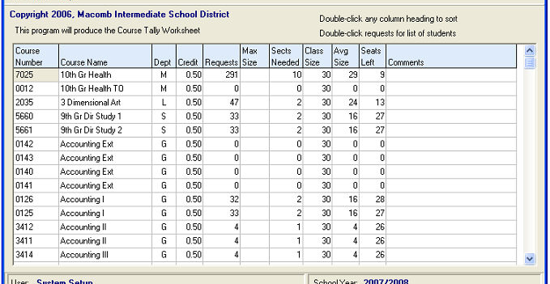
Sample Course Request Tally

Slide 7
Tallies
Determine resource needs and review assignments (solicit teacher/pathway/ department preferences; know possible FTE/budget changes; decide when to assign teachers and rooms to course sections, etc.) (tools include: course enrollments and requests report; staff projections; tallies)
Prepare Schedule Board/s, section chips (if appropriate), and your “game plan” (order of placing sections

Slide 8
A Pathway Sidebar
Determine….
The courses that will be pathway-specific at each grade level (as appropriate)
The percentage of the student day that will be spent in pathway specific courses
The number of teachers needed on each pathway team to support pathway student enrollment

Slide 9
Scheduling Sidebar
To facilitate data gathering, analysis and program evaluation it is helpful to identify (tag/flag) specific students and structures in your program.
Students in the pathway
Courses in the pathway
Teachers on the pathway team
Other site specific structures/courses

Slide 10
An Invitation to Share
CCASN will continue to add and refine resources and tools included in the CCASN Master Schedule Guide. We invite you to share your own master schedule tools, strategies, and effective practices.
Please share resources and suggestions with Patricia Clark (patricia510@gmail.com) and/or Phil Saroyan (jp9@jps.net)
THANK YOU.

