Slide 1
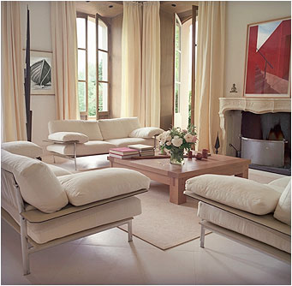
Principles & Elements of Interior Design
Evaluates

Slide 2
Principles of Design
Design Fundamentals
The fundamentals are known to most professionals as the principles of design.
Proportion
Rhythm
Emphasis
Balance
Scale
Harmony

Slide 3
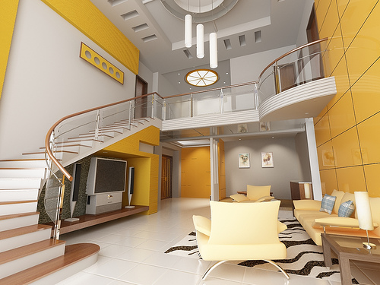
Principle of Scale
Scale – the entire perspective. The objective with scale is for objects to be alike or harmonious in dimensions or mass as they relate to each other.
Notes:
. For example, in general, large scale furniture and motifs do well in large scale rooms. When you move from a smaller home into a larger one, you may think, ‘My furniture seems so small.’ It is not that your furniture is ‘small’; it is just not in scale with the size of the room.

Slide 4
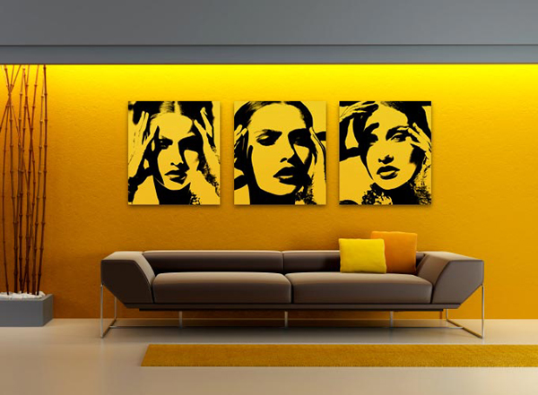
Principle of Proportion
Proportion – evaluates the relationship or ratio of parts to the whole.
Notes:
You have seen examples of an object out of proportion, I’m sure. When it happens, the eye is not pleased. A common one is hanging a small picture on a large wall creating too much negative space. The ratio of positive space to negative space is grossly disproportionate causing the entire wall to appear cold or underdeveloped. A larger picture, grouping compatible pictures together, or anchoring the small picture with a piece of furniture are some methods of solving this example problem.

Slide 5
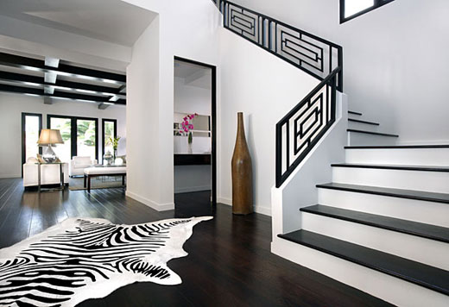
Principle of Rhythm
Rhythm – speaks to the flow within a room and throughout your home.
Notes:
Recall the discussion of public versus private space. Rhythm is the flow of elements usually organized according to a scheme such as repetitive pattern. You can have a lot of fun creating rhythm. I used a diamond pattern in the window treatments and decorative pillows for a client’s master bedroom. She not only embraced this concept but added crystal pieces in the room to have it figuratively and literally sparkle.

Slide 6
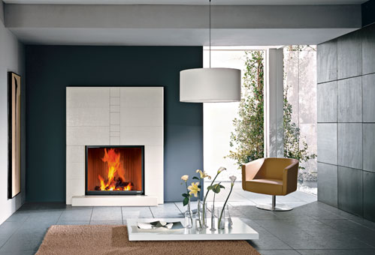
Principle of Emphasis
Emphasis – is the important focal point(s) in a room. There may be more than one focal point but one will be primary
Notes:
. A fireplace in a family room will likely be the focal point of that room. There also may be a media center as a secondary point of interest. Furniture will be arranged such that your eye will be guided toward the focal points; in this example, toward the fireplace or a media center.

Slide 7
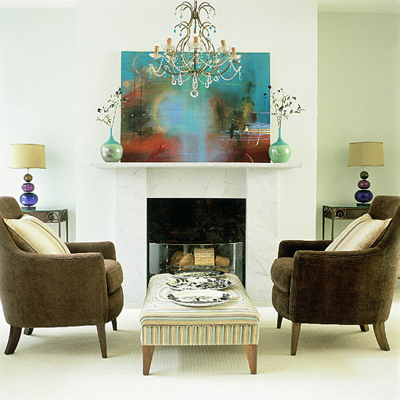
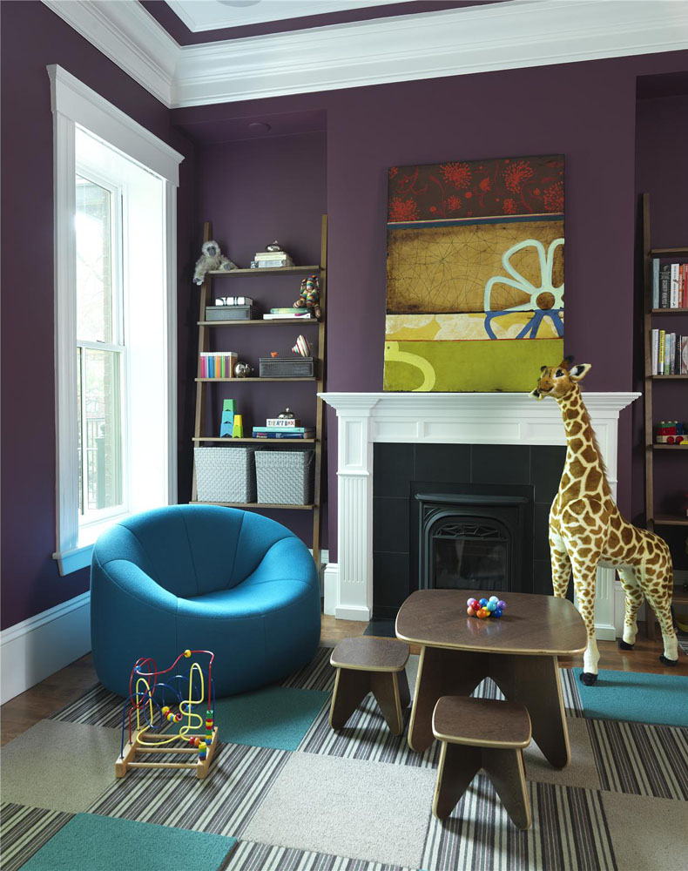
Principle of Balance
Balance – is equilibrium though symmetry (mirror images from a center point), asymmetry (optically varying items from a central point to achieve balance), or radial (equilibrium based on the circle
Notes:
). Symmetry has a more formal appearance and feel, for example bookcases flanking the door of a den. Balancing with asymmetry is more difficult to accomplish as the eye is used to create it but the results can be wonderful.

Slide 8
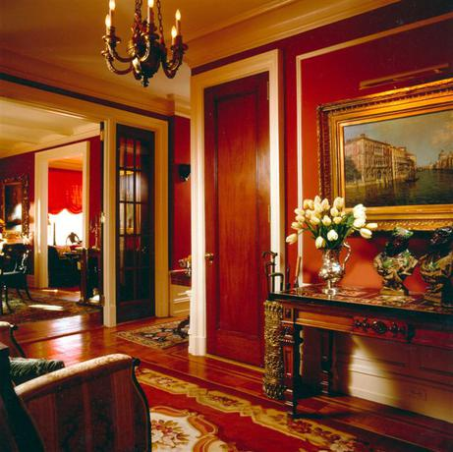
Principle of Harmony
Harmony – is creating a feeling of suitability through unifying elements and objects and adding variety for interest and diversity. The objective is to create an agreeable, appealing whole that won’t tire in the long-run.
Notes:
For example, I’ve used the color red, a warm hue, as a flow element in my home. I have used neutral and cool hues also throughout to add interest and diversity; too much of a good thing can actually become monotonous over time.
For example, I’ve used the color red, a warm hue, as a flow element in my home. I have used neutral and cool hues also throughout to add interest and diversity; too much of a good thing can actually become monotonous over time.

Slide 9
Elements of Design
Design Elements
The elements discussed here are used by artisans of all types — painters, sculptors, photographers, interior designers, etc. They have been discovered and refined over the course of history and are considered elementary and critical to all fine-art. They are
Space
Shape & Form & Mass
Line
Texture & Pattern
Light
Color

Slide 10
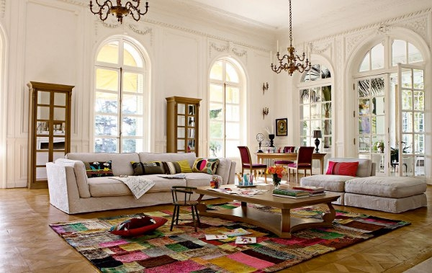
Element of Space
Space – as humans, we need both large and small areas to please our psyche There also needs to be a comfortable balance and proportion of positive, filled area, and negative, unfilled area.
Notes:
. Incorporate both, or the appearance of both, in your home. Traffic paths are negative space in a room yet functionally important. An example of too much positive space is filling a small room with oversized furniture. You can use large pieces in a small room balanced by massing, placing together, smaller scale items that allow for more negative space in between (this is also an example of asymmetrical balance).

Slide 11
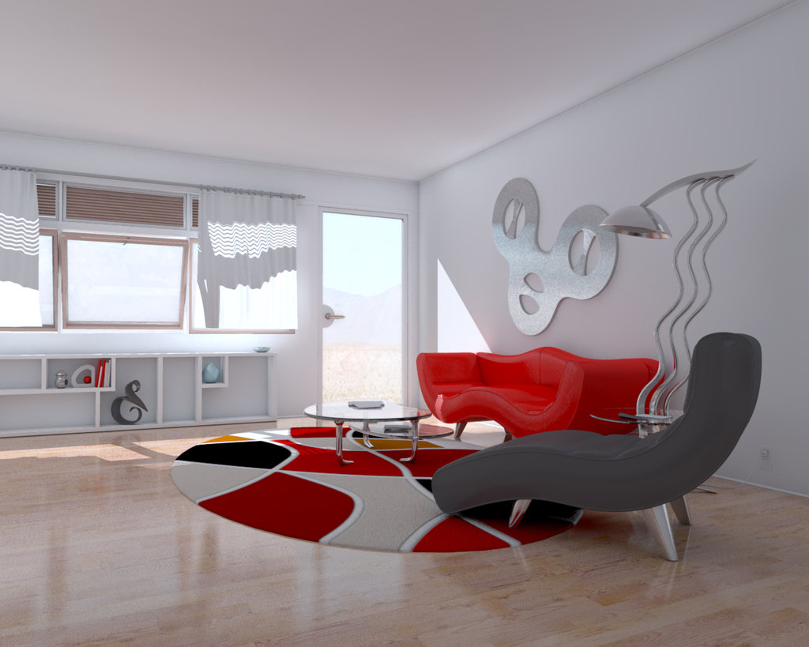
Element of Shape & Form
Shape and Form – Shape is the two-dimensional outline while form is the three-dimensional configuration.
Notes:
With shape and form, think of those pleasing to the eye and that are well proportioned and complement each other. If you like geometric forms, you’ll need to soften it by adding curved pieces. This will accomplish balance and harmony and ultimately a more comfortable feel.

Slide 12
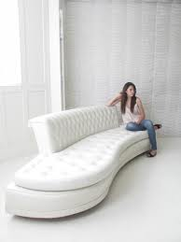
Element of Mass
Mass – is the actual or optical density of an object.
Notes:
The mass of a glass table will appear less than one of the same dimensions made of wood. This is known as optical density. In one of my designs, I placed an arrangement of three large scale upholstered pieces, a settee and two chairs, and two oval wood and glass end tables. The final piece to the arrangement was a rectangular glass coffee table. Given the scale of the room, moderate, and the focal point being on the opposing wall, I chose a suitably proportioned rectangular glass coffee table consistent with the grandeur of the furniture to decrease the mass of the arrangement as a whole. This brought balance and harmony and allowed full view of the point of interest in the room.

Slide 13
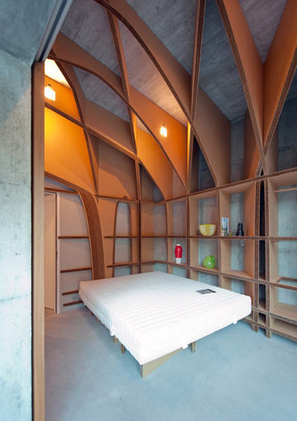
Element of Line
Line– is used to create width and height, or the appearance of activity, movement, or flow.
The psychological effect of line ranges from
secure (horizontal line)
free or expansive (vertical)
action-oriented (angular) to
soft and comforting (curved)
Notes:
The most pleasing effect will have a balanced mixture of lines with one taking the lead role. The dominant line will be chosen dependant upon what feeling or image you would like to portrait.

Slide 14
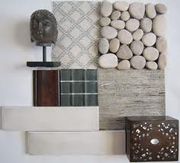
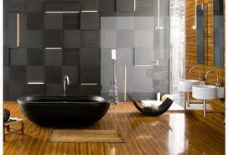
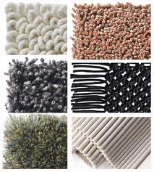
Element of Texture
Texture – is the actual physical feel or surface appearance of a furnishing or treatment.
Notes:
All fabric has texture but a faux wall treatment can also give the appearance of a texture when, to the touch, it may be completely smooth. The textures of fabric and treatments need to be compatible but varied for harmony. In a monochromatic room, texture is a critical element to plan for and vary to please the eye and maintain attraction.

Slide 15
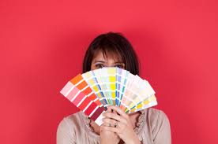
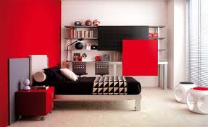
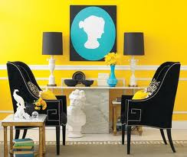
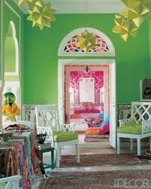
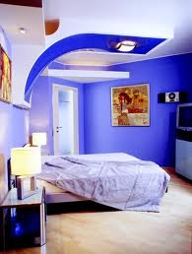
Element of Color
Color – is the most personal and evocative element in design. We all have our favored and least favored color(s) and many people have associations to particular ones.
Colors are considered warm (reds, yellows, and oranges), cool (blues, greens, and purples), or neutral (beiges, browns, black, grays, and whites).
Light colors provide a more spacious feel; dark ones aid with coziness. Bright colors can be energizing; dull more soothing and easier to live with over time. It depends on what you’re trying to achieve. A child’s room will have a different color palate than a home office.

Slide 16
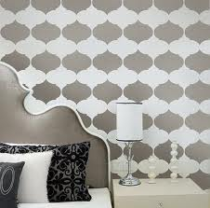
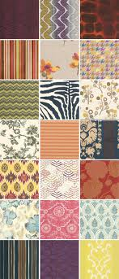
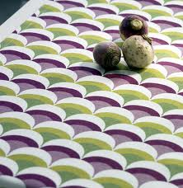
Element of Pattern
Pattern – is forms arranged in an orderly manner. Combining patterns can be a bit tricky but beautiful. When combining, one pattern will be dominant with others in supporting roles.

Slide 17
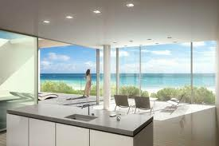
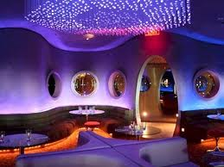
Element of Light
Light – is a critical element in all fine-art. You can design a gorgeous room but if it is poorly lit, you may not be able to appreciate it.
Natural daylight and artificial light are both considered in planning interiors.
Colors, textures, and patterns can be true or altered primarily dependant upon your artificial lighting

Slide 18

Finishing
Knowing the principles and elements of artful interior design provides an excellent foundation.
Applying the principles and elements takes thoughtful selection and placement combined with your personal preference and imagination.
Your eye is the ultimate judge of good design for you. It takes time and you may never be ‘done.’ It is like raising a child; there is always something to nurture, something to organize, and something that is not going to behave just as you’d like it to. That’s part of the challenge and the beauty.
The Principles of Design
Proportion
Rhythm
Emphasis
Balance
Scale
Harmony
The Elements of Design
Color
Light
Pattern & Texture
Line
Shape & Form & Mass
Space

