Slide 1
Master Schedule Board Instructions
Run this PowerPoint as a slide show so animations will work properly.
Dear Scheduling Team,
The Master Schedule Board is an Excel spreadsheet that was first developed in the mid 1980's when student information systems (SIS) were in their infancy and didn't provide many of the features of today's current master scheduling systems. Depending on your SIS, the use of this Master Schedule Board may be a duplication of effort. The following is a list of the features of the Master Schedule Board to help you decide if you want to use this tool:
1) This is a ready to fill in, blank master schedule template that will handle up to 4 grade levels and 9 periods of class. If you routinely produce your own version of your master schedule using Excel or other applications independent of your SIS, this tool will save you time in developing the format of your master schedule.
2) Once the Master Schedule Board template is filled in with your school's information, a publication master schedule is automatically produced.
3) Once the Master Schedule Board template is filled in with your school's information, a room assignment by room and a room assignment by teacher list is automatically produced.
4) The main purpose for developing this tool was to assist in balancing the master schedule. Once filled in with the counts from the student course request tally, this tool gives you several ways to examine balance in the master schedule including seat counts by period and grade. This provides you with information on where to move sections to balance the master schedule.
5) The impact of mainstreaming is evaluated in terms of the use of the school's staffing allocation. In some cases, with the addition of special education teachers, a school's staffing allocation is enhanced; in some cases, mainstreaming/full inclusion reduces the seats in general education classes such that extra staffing is justified. This information has been used in some districts and extra staffing has been provided as a result.
Happy Scheduling!! Phil Saroyan (jp9@jps.net) & Patricia Clark (patricia510@gmail.com)

Slide 2
When is Master Schedule Board Used?
This tool is used at two different times for balancing the master schedule:
During the building process - there is a point when you have decided on the number of sections of each course you need to place in the master schedule. You also have tentatively decided on the specific period placement of many if not all of the sections through the use of a course conflict matrix. At this point you don’t know for sure if all of the students will be scheduled properly when you submit your schedule to the student information system (SIS) to simulate a match between the student requests and the schedule you developed (a SIM run or Loader run). The two most common mismatches are conflicts between sections offered during the same period and periods without sufficient sections to accommodate all students – in other words, a problem with balance in the master schedule. The Master Schedule Board tool is used at this time. You input the sections in the period placements you have developed with the counts from the student course request tally. Once this is done, this tool with show you, period by period, if your schedule will accommodate your students. It also provides you with several charts to assist you in balancing your schedule if needed.
After school starts – when you have “real” students sitting in classes, by inputting actual student counts for each section, the same charts that assisted you in balancing your master schedule with the projected counts from the student course request tally, will assist you in balancing class loads.

Slide 3
A Special Note About the Counts to be Entered from the Student Course Request Tally
There are three procedures to follow when using the student course request tally to enter section counts in the master schedule board:
In courses where sufficient student requests have been made to allow for more than 2 sections to be offered, enter the contractual class size maximum as the student count for each section.
In courses where the counts are such that only one or two sections will be offered, take the student request count, divide it by the number of sections that will be offered and use that number as the class size. For example – if 40 students requested a course and you decide to offer two sections, use 20 as the student count in each section.
In courses where students of multiple grade levels request the course, use “splits” as the counts to enter. For example – if 125 grade 9 students and 162 grade 10 students requested the same course, that would be a total of 287 students. If you had a maximum class size of 32, you would offer 9 sections of this course. Divide each student count by 9 sections to get the count to enter in each section for each grade – 14 for grade 9 and 18 for grade 10. This happens to work out to a total of 32 for each section, but if your particular case does not equal the maximum class size, just equally add numbers to each grade level count to make the sum of the splits equal to the maximum class size.

Slide 4
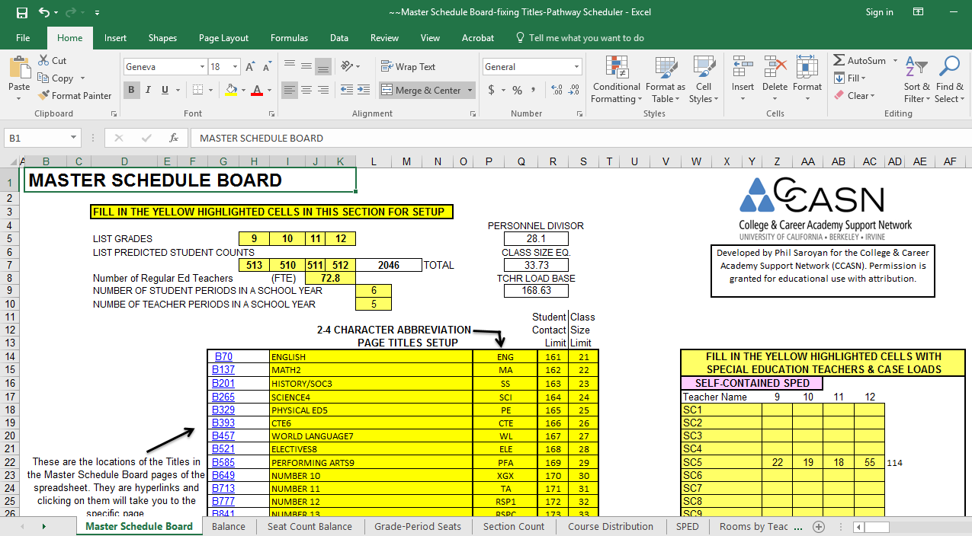
Layout of the Master Schedule Board Tool
This workbook is composed of 14 linked spreadsheets. When you open the workbook for the first time, you will be on the tab of the “Master Schedule Board” spreadsheet shown here.
Tabs to access the 14 spreadsheets of this workbook
Click here to scroll through the tabs

Slide 5

Master Schedule Board Big Picture
This is a much reduced view of the first 2 pages of the spreadsheet on the Master Schedule Board tab. This is intended for orientation only – you will be able to read these pages on upcoming slides. Page 1 is a setup page. You enter your school specific information here. On pages 2-27 you enter your master schedule information for your general education sections. On pages 28-32 you enter your master schedule information for you Resource sections. On pages 33-37 you enter your master schedule for your Self-Contained Special Education sections. This master schedule board will accommodate 4 grade levels, 9 periods, 26 groupings of General Education sections, 547 General Education teachers, 15 Resource teachers and 15 Self-Contained Special Education teachers.
Page 1
Page 2 - 37

Slide 6
Setup
When you open Master Schedule Board for the first time, go to the input area that begins at cell H5 of the Master Schedule Board tab; your yellow shaded cells will be blank. Fill in all the appropriate shaded cells in terms of a year’s schedule. The next 3 slides give you detailed setup information.

Slide 7
Setup-1
Special Note:
Throughout this tool, input information only in cells that are highlighted in a shade of yellow. The cells with formulas are locked so you can’t inadvertently delete a formula, but they are not hidden so you can inspect the function of this tool. If you click on a cell with a formula, you will get a message telling you the cell is locked and that you need a password. Just click on “OK” to continue
Setup Example
Fill in the information for your school in the yellow highlighted cells

Slide 8
Setup-2
Next, go to the Special Education input section area that begins at cell W14. Your yellow highlighted cells will be blank. Fill in the teacher names and student counts by grade for your Special Education classes. Leave cells blank where there is no information to input. The teacher names you input are automatically transferred to the appropriate Section Input Pages for Self-Contained and Resource sections. There will be more on SpEd input later in these instructions.

Slide 9
Setup-3
The Schedule Page Setup
Here you set up 4 items for each schedule page:
Page Title
Page Title Abbreviation
Student Contract Limit
Class Size Limit
Let’s take a close look at these on the next slides
These are hyperlinks that take you to each schedule page

Slide 10
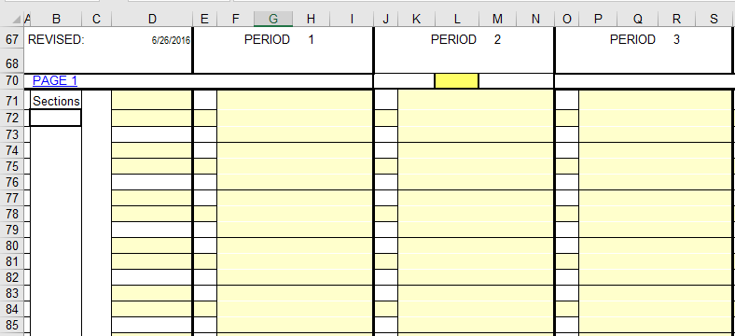
Here you see just the top row from the previous slide
Below, you see just 3 periods and 5 rows of the first schedule page. Notice that the title (Page 1) form the yellow highlighted setup cell (I14) is copied to cell B70. The titles on each of the schedule pages are also hyperlinks that take you back to the top of the spreadsheet.

Slide 11
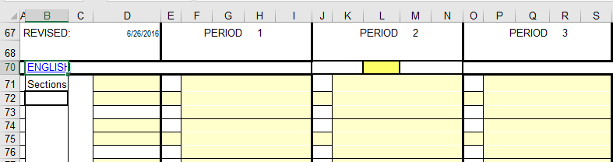
You can set up the first 26 schedule pages any way you want with any combination of classes. You can set the schedule input pages up by Department, Academy or any combination of either. Let’s begin by setting up the first page by the English Department. Below is an example of how it would look.
Below you see that the title “ENGLISH” has been copied to the schedule page. I will talk more about the Abbreviation, Student Contact Limit and the Class Size Limit on the next slide.

Slide 12
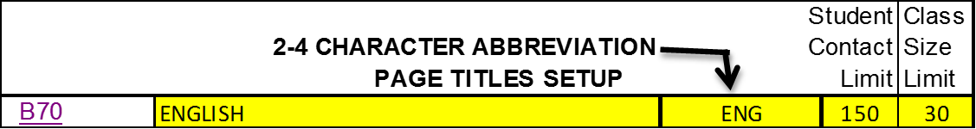
The Schedule Input Page Title
The Abbreviation is needed for convenience of entry that you will learn about in just a bit and it is used as a lookup to compare a teacher’s student contact and class size limits to actual counts.
The Student Contact Limit is the maximum number of students that can be assigned to a teacher. Sometimes this will vary depending on the subject.
The Class Size Limit is the maximum number of students that can be assigned to a section of a course. Again, sometimes this will vary depending on the subject.

Slide 13
Now, let’s take a look at the data entry for the Schedule Pages. Below, you see just 2 of the 9 periods with everything blank except the title (ENGLISH) that we already set up.
Here you see an enlargement of just one period block illustrating that it is composed of 15 individual Excel cells labeled A – O. The lines dividing the cells are drawn to aid in the instructions and are not present as shown above. The yellow highlighted cells are locations where you will input specific information about the section – in this case a 1st period section in the English Department. We will do the input on the next slide.
N
A
B
C
D
M
E
F
G
H
O
I
J
K
L

Slide 14
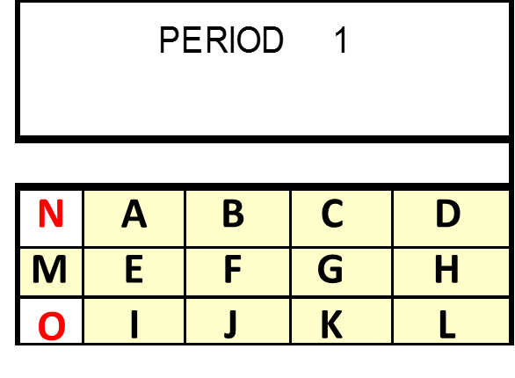
Layout for Input into the Master Schedule
Special Note: Cells I, J, K, and L are the only cells that can contain numerical values. Entries in cells A-H must begin with an alphabetical/non-numerical character (numbers in cells A-H must be preceded by letters, an asterisk or quote marks. Do not use parentheses – Excel will treat a number in parentheses as a negative number yielding inaccurate results.
Cells A, B, C – Enter course title here – input in cell A and the title can extend through cell C
Cell D – Reserved for room number only. Always enter the room number with an alphabetical/non-numerical character first, for example: Rm 5 or C7 or *12 or “27”
Cells E, F, G, H – These cells can be used for any information you want – as long as the entry begins with an alphabetical character. These cells are sometimes used for the course number. If you do this, be sure to enter the course number with a leading alphabetical character – for example: *2301
Cell I – Reserved for student counts in the grade entered in cell H5 (most likely 9th grade)
Cell J – Reserved for student counts in the grade entered in cell I5 (most likely 10th grade)
Cell K – Reserved for student counts in the grade entered in cell J5 (most likely 11th grade)
Cell L – Reserved for student counts in the grade entered in cell K5 (most likely 12th grade)
Cell O – This cell contains a formula that will add the total of cells I, J, K and L
Cells M & N – These cells work with each other in a special way that I will explain after a few more slides.

Slide 15
Below you see two sections filled in consistent with the format explained in the previous slide. Throughout these instructions, I will be using cell “I” for grade 9 student counts, cell “J” for grade 10 student counts, cell “K” for grade 11 student counts and cell “L” for grade 12 student counts.
Room Number
Section Count Total
Displayed in Red Bold –see next slide for details
Course Title
Section Count Total
Course Number
Grade 12 student counts
Grade 9 student counts
Grade 10 student counts
Grade 11 student counts
Grade 12 student counts

Slide 16
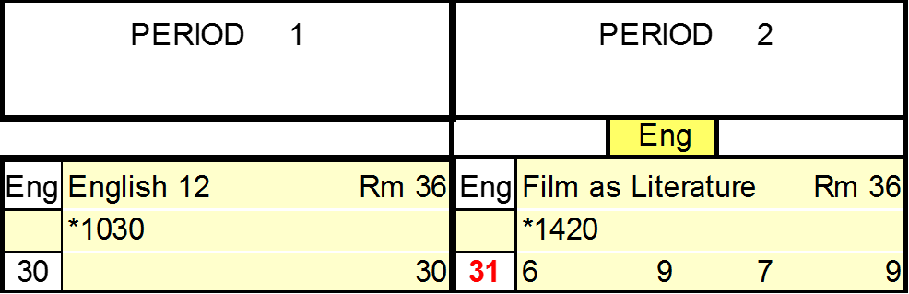
Previously, we set the class size limit for English at 30
When the total number of students in a section is over the set limit, it will be displayed in RED BOLD
On the next slide we will see how this works

Slide 17
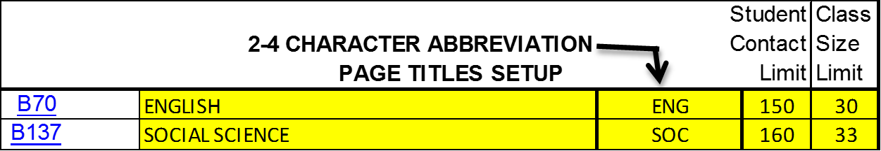
In the “by department” example we are working with now, all of the sections in this scheduling page will be in the English department.
This cell (L70 in this example – and remember L70 because I am going to refer to this cell in a few slides) tells all the sections on this scheduling page to use the ENGLISH “Student Contact” and “Class Size” Limits. This cell is highlighted in yellow meaning that you need to input the information. Here you input the abbreviation you listed from the Schedule Page Setup (not case sensitive so ENG or Eng or even eng is fine.
When you enter a Course Title in one of the section blocks, the abbreviation will automatically appear here. Then, when you enter student counts, a lookup formula determines if the total number of students is over the class size limit – if so, the total appears in RED BOLD.

Slide 18
But what if a particular teacher also teaches a section in another department?
No problem!! Just add the section to the schedule like this….
…then change the abbreviation to “Soc” in this location as shown below
Notice that by entering “Soc” the “Eng” is replaced with “Soc” and the total count of 33 no longer shows in RED BOLD because the Class Size Limit we entered for the Social Science department is set at 33

Slide 19
Another method of entering the sections for a teacher having sections in different departments is shown below:
This is the English Department Schedule Page – In this example, only the English sections for the teacher are entered here. It is helpful to enter a reminder note here.
Below is the Social Science Department Schedule Page – only the Social Science sections for the teacher are entered here. Again reminder notes have been entered.
It makes no difference which way you enter a teacher’s schedule – all on one line as in the example on the previous page, or in separate places as on this page. Also, if you want to enter some teacher schedules one way and some teacher schedules the other way, that is fine too. Whatever is convenient for you.

Slide 20
A Special Note About Course Title Entry
Course Titles ONLY should be entered in the uppermost left cell of the section input block.
Any entry in the Course Title cell will automatically populate an entry in the department designation cell.
Any special note you wish to include can be placed in the center row of the section input block as long as it doesn’t begin with a number. Course numbers can be preceded with an asterisk, for example: *1030

Slide 21
Academy Entry
You have probably already figured this out from the instructions on the previous slides, but entering an academy on a single Schedule Page is essentially the same as the example where we placed the English and Social Science sections on the same Schedule Page. All you need to be sure to do is enter the correct abbreviation for each section.
Here is an example of how the “Page Titles Setup” page might be filled in.
We will be using these abbreviations in just a little bit, so add these to your memory bank along with cell L70.

Slide 22
Here is an example of a complete academy entry – the Biomedical Academy. This is a little difficult to read, so after the next slide we will take a closer look. Notice here That the 8 teachers in this academy have a common prep period and that it has been highlighted in a different color. Highlighting can really help organize your master schedule.

Slide 23
This may be a bit too much, but it is an example of utilizing highlighting the different sections by department.

Slide 24
A Closer Look
Ok – here is where we will be referring to cell L70 and using the abbreviations for some more features.
Here you notice that teacher names have been added. Teacher names are added only in column “D” and only in the top cell of each teaching line.
Since cell L70 is set to “Eng” a teacher’s maximum student contact limit is evaluated based on what was entered in the Page Setup section –165 is what we set in this example. The total student count (160) is shown in this location for each teaching line.
If the total student count from all of the sections in a teaching line is over the maximum, it will appear in RED.

Slide 25
A Closer Look
Since L70 is set to “Eng” the Department affiliation for each teacher automatically begins set to the English Department. The Department affiliation is listed in column “C” and will appear after a teacher name is entered.
If you want to set a different department affiliation, enter the abbreviation for the department in the yellow highlighted cell just below the teacher name.
Once the new department affiliation is entered in the yellow highlighted cell, the listing in column “C” will automatically change. Then, the teacher’s total student contact limit will be evaluated at the new department affiliation.

Slide 26
A Closer Look
41 is the total number of sections listed on this Schedule Page.
This is the total number of sections assigned to this teacher line – This shows that teacher “Wright” has 5 sections.
If a teacher has more sections than you listed in the setup (cell L10), the total will show in RED.

Slide 27
Back on slide 8 of this PowerPoint, we entered this sample information for the Self Contained Special Education and Resource teachers. When the teacher names are entered here, they are also automatically entered in the proper location of the master schedule board. On the next slide we will look at the data entry for the RSP teacher, Adams. The same procedure is used for the data entry for all Self Contained and RSP teachers.

Slide 28
This is the Schedule Input Page for just one special education teacher, in this case the Resource teacher, Ms. Adams. The only difference between the input in this area and the regular education teacher area is that this area provides you the ability to list multiple sections in one period for the teacher (in this case, Ms. Adams). As an example, Ms. Adams is teaching one section of English 9 and one section of English 10 during first period. We will look at more detail in the next slide
Period 1
Period 2
Period 3
Period 4
Period 5
Period 6

Slide 29
Ms. Adams has 11 grade 9 students and 6 grade 10 students. She has all of her students during period 1 & 2 providing the grade level appropriate instruction in English and History. During period 3, Ms. Adams goes to room 31 with some of her students to collaboratively teach Science with Ms. Lavering. During period 4, Ms. Adams goes to room 63 with some of her students to collaboratively teach Algebra with Ms. Duncan. During period 5, Ms. Adams has all of her students in her Study Skills class. Period 6 is Ms. Adams preparation period.
Period 1
Period 2
Period 3
Period 4
Period 5
Period 6
As you can see, the input for each section is exactly the same as described for the general education section input pages. The only difference is the ability to list multiple sections (up to 6) each period.

Slide 30
A Closer Look
This shows the total number of sections listed for Ms. Adams
These are the counts of the number of sections listed in each section row for Ms. Adams
This is the total number of student contacts for Ms. Adams
REMEMBER: Be sure to account (through the student counts you enter) for all students each period they are taking classes with their special education teachers. These counts are used to determine the influence of your special education program on your staffing allocation. This will be explained later in this document.

Slide 31
Now you are ready to enter your master schedule on the schedule input pages
Summary of steps:
Fill in all of the set-up information
  Grade Levels
  Student Counts
  Student Periods
  Teacher Periods
  Titles Setup for Section Input Pages
  Special Education Teacher and Case Load Setup
Fill in Section Input Pages
Course # or notes in middle row
Course Title (ONLY)
Teacher Name
Room Number
Teacher Department change (optional)
Student Course Request Counts or actual counts after school starts
Section Department change (optional)

Slide 32
Once the schedule board is filled in, click on the Print Copy tab to find this short version of the master schedule. It is currently set to print 17 pages on legal sized paper in landscape orientation. The printing parameters are easily changed to meet your needs by changing page breaks or by using the Print Area function of Excel. The enlarged section at the bottom shows the information provided: the teacher name with the course taught and room number for each period. The example below is organized by department.

Slide 33

Getting Balanced
Once all the information is input into the schedule board (including the student counts by grade for each section), 7 different charts are generated to analyze the balance in your master schedule. Each chart is on a separate tab. The tab labels are:
Balance
Seat Count Balance
Grade-Period Seats 1
Grade-Period Seats 2
Section Count 1
Section Count 2
Course Distribution
We will take a look at each one of these tabs on the following pages.

Slide 34
The Balance Tab
This tab, as is the case in all 7 balance tabs, uses the seat counts input on the Master Schedule Board tab to show you details about the schedule you have input. The seat counts used in this example come from the student course request tally where class size maximums are used. Once school starts, input actual numbers on the Master Schedule Board to help you further balance the school. Below, you see that the seat and section counts are fairly balanced. Periods 3 & 4 have the highest counts and period 6 the fewest. This may indicate a need to switch sections from 3rd or 4th to 6th. Just something to investigate. Once real counts are entered, the overall class size average will be more realistic and maybe surprising!!

Slide 35
The Seat Count Balance Tab
This is the main tab that is used to fine tune the balance of your master schedule. The first of the 3 columns for each grade level shows you the total count of seats for the period, the second column shows the seat balance which is the difference between the number of students in the grade level and the number of seats you have made available in the schedule, and the third column translates the seat balance into a section count. For 1st period in the 9th grade there are 529 seats in the master schedule. This is 49 more seats than the 480 grade 9 students in school which is 1.58121 sections (someone asked for more accuracy – so I did it). The negative numbers in periods 7-9 are because this is a 6 period bell schedule. Let’s go to the next page for a closer look.

Slide 36
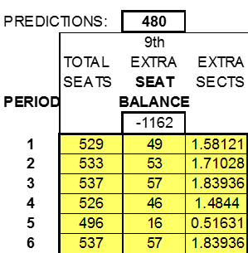

The Seat Count Balance Tab
This master schedule is fairly well balanced. I usually like at least one full class size worth of extra seats in all periods at all grade levels. If you take a look back at the previous page, you will see that this is pretty much the case except for grade 9 during 5th period with only 16 extra seats. Taking a look at the 9th grade counts, 6th period in the 9th grade has the most extra seats with 57 (chart below on the left), so that is a place to look to see if you can move a section from 6th period to 5th. Once this is done, there is a much better balance (chart below on the right). The sections to move are the ones from courses with the highest number of sections – you don’t want to move singletons that you have strategically placed using the conflict matrix. If there are no pure 9th grade sections to move, look at sections that contain multiple levels of students that include 9th grade students. Once you are satisfied with the seat balance of your master schedule you are ready for your first loader run (SIM run) in you student information system.
The next 3 slides use animations to review the use of the Seat Count Balance information. Be sure you are viewing in Slide Show mode or the animations won’t work.

Slide 37
Seat Balancing by Grade and Period
Seats Seat Sects
Balance
Seats Seat Sects
Balance
Seats Seat Sects
Balance
Seats Seat Sects
Balance
The red boxes indicate periods where seat counts are negative or low enough to cause concern. Twelve seats are a concern because the 10th grade class of 470 needs about 15 sections of class per period – this gives less than one extra seat per section. In an exceptionally balanced master schedule you should have at least 1 extra seat; most of the time we shoot for at least two extra seats per section.
The green boxes indicate periods where seat counts may be excessive and where sections could be reduced and relocated into periods with shortages.
In the next slide we will balance the seat count in the 9th grade.

Slide 38
Seat Balancing by Grade and Period
Seats Seat Sects
Balance
Seats Seat Sects
Balance
Seats Seat Sects
Balance
Seats Seat Sects
Balance
1
2
3
4
5
6
7
8
9
9th Grade class from
6th
6th
7th
9th Grade class to
4th
2nd
2nd
Sections to move for balancing the 9th grade
Enlarged view of 9th grade
Balanced 9th grade

Slide 39
Moving Sections
Moving sections is accomplished by going back to the schedule board section of the Master Schedule Board tool and deleting the section information in the period to be moved and then re-entering the section information in the period where you need it. Click to see an example of moving a 9th grade English section from period 2 to period 3
English 9
Rm 9
English 9
Rm 9
32
32
32
32
Seat count total
Remember, only change information in the yellow highlighted areas. The seat count totals for each period are automatically calculated. After this change, the 9th grade seat count in the Seat and Section Counts by Period and Grade table will be 32 less in period 2 and 32 more in period 3.

Slide 40
The Grade-Period Seats 1 Tab
This is the SEAT COUNT BY GRADE, PERIOD AND SECTION COURSE LABEL sheet. The specific thing to remember about this sheet is that it is organized by the Section Course Labels that you have assigned to each section on the master schedule board. Let’s take a closer look on the next page.

Slide 41
The Grade-Period Seats 1 Tab
The first 4 rows in the chart below are the academy pages from the master schedule board. Each academy has 40 sections, but no seat counts appear in this chart because each section in the academy has a course label (Eng, Soc, Sci, or Cte) so the seat counts appear on the row consistent with the course label. For example, all English seat counts from the 4 academies appear in the row for the English page. The English sections on the English page of the master schedule board also contribute to the totals listed here. One can think of this chart as the seat count by Department listing.

Slide 42
The Grade-Period Seats 2 Tab

Slide 43
The Grade-Period Seats 2 Tab
This tab is the SEAT COUNT BY GRADE, PERIOD AND MASTER SCHEDULE BOARD PAGE. This chart lists the seat counts from each individual page of the master schedule board. On this tab, contrary to the previous tab, you do see the seat counts for each academy.

Slide 44
The Section Count 1 Tab
This tab is set up identical to the Grade-Period Seats 1 tab described on slides 37 & 38, except instead of listing seat counts, here the section counts are listed.

Slide 45
The Section Count 2 Tab
This tab is set up identical to the Grade-Period Seats 2 tab described on slides 39 & 40, except instead of listing seat counts, here the section counts are listed.

Slide 46
The Course Distribution Tab
This tab is very useful as a check on the total number of sections in the master schedule for each course. All you do is enter in the yellow highlighted column the EXACT course title as listed on the master schedule board page. Once entered, the count of sections by period is displayed. If you do not enter the course title exactly as entered on the master schedule board page, no results will be displayed (example: US History below shows no results because it is entered as US Hist 11 on the master schedule board). The total count of all sections is also listed. There is room to enter up to 500 course titles. You may wish to just enter a listing of all courses the first time you use this tool and just update the list each year as needed. Hopefully you can just download your course file from you student information system and just paste the list in the yellow highlighted column.

Slide 47
The SPED Tab
In the school district where I worked, there were two major categories of special education students: Resource (RSP) and Self-Contained (SC). In determining the FTE allocation, the RSP students were counted with the general education students, but the SC students were not. In addition to the calculated FTE based on the general education students plus the RSP students, additional RSP teachers and SC teachers were provided.
Imagine in a school we have 120 RSP students and 30 SC students. Imagine further that the school is provided 2 additional RSP teachers and 2 additional SC teachers. Let’s look at two scenarios. In the first scenario, all RSP students take 2 periods of class from their RSP teachers and 4 periods in regular education classes. Also, all SC students take 4 periods with their SC teachers and 2 periods in regular education classes. Since the RSP teachers are additional FTE and the RSP students are counted in the calculation to determine the regular education FTE, any periods that RSP students are in classes with their RSP teachers creates additional seat space in the regular education classes. So, if 120 RSP students are taking 2 classes with their RSP teachers, the equivalent of 4 sections of class (at a class average of 30) are saved in the general education allocation. The opposite is true with SC students. They are not counted in the FTE allocation so when the SC go out for their 2 periods of class, they impact the general education FTE allocation by 2 sections. The combination of the RSP and SC impact benefits the general education FTE by 2 sections ( 4 sections minus 2 sections).
In a second scenario with all the same student and teacher details, but with full inclusion, the benefit to the general education FTE from the RSP students would be negated and the result would be the 30 SC students taking 6 periods of class in the general population. With this scenario, a total of 1.2 FTE is utilized by the SC students – maybe an argument for an additional FTE allocation.
There is nothing to enter on this page – you just look at the bottom line. All the information needed is gathered from what you enter on the master schedule board pages. Depending on the number of special education students and the degree of general education inclusion of special education students, you may have a valid argument for additional FTE. You will see one of two messages:
This one
OR
This one
Go to the next page to see examples of the SPED Tab page

Slide 48
The SPED Tab
This is a view of the entire SPED Tab with the FTE impact such that extra staffing may be appropriate.
This is an example of just the bottom of the SPED tab showing a benefit to the general education FTE.

Slide 49
The Rooms by Teacher Tab
The information on this tab is automatically populated once you enter the teacher names in the yellow highlighted column. Be sure to list the teachers only once and spell the teacher names EXACTLY as you have them spelled on the master schedule board pages. If you have scheduled two teachers in the same room during the same period, the room number will appear in Red Strikethrough.

Slide 50
The Rooms by Teacher Tab
The easiest way to input the teacher names is to copy them from the master schedule board page and paste them into column A, but there is a little trick to learn so this can be done.
The teacher names are listed in column D of the Master Schedule Board page, but they are separated by 2 cells. What you want to do is just select the teacher name cells. On a PC, if you hold down the Control (CTRL) key and then click just once on each teacher name cell, it will just select the teacher names (on a Mac you can do the same thing using the Command Key). Continue selecting all of the teacher names down column D on the entire Master Schedule Board page. Don’t worry if you have listed teachers more than once, just keep selecting all of the names – we will take care of duplicates in a bit. Once all of the names are selected, copy the names to the clipboard. Next click on the Rooms by Teacher tab and select a cell to the right of the chart – for example, cell M9. Next, paste the teacher names you have copied. They will appear as a continuous column of names without the two spaces between each name. I use the “Paste Special” function and just paste “Values” so the highlight and cell border formatting from the Master Schedule board won’t be copied. See the next page for a screen shot of the “Paste Special” function and the paste “Values” function.

Slide 51
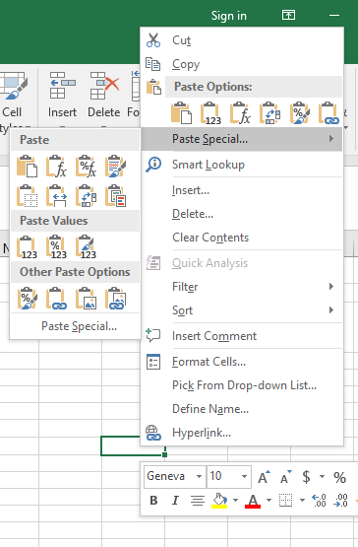
This is the “Paste Values” option.

Slide 52
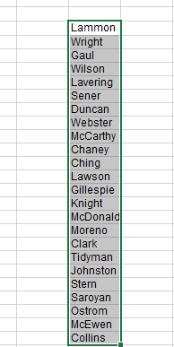
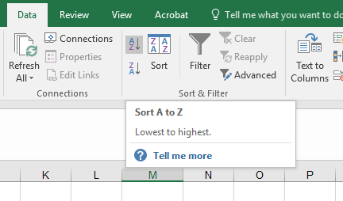
Next, sort the list of names you just pasted on the spreadsheet.
1) Select the entire column of names
2) Click on Excel’s “Data” tab
3) Click here to sort from A to Z

Slide 53
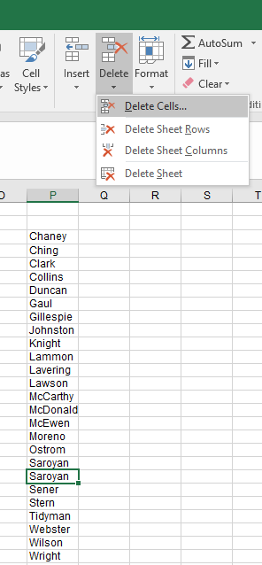
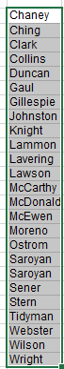
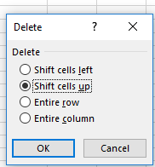
The list will now be alphabetized. If you have duplicate names as shown here,
delete them by following this procedure:
1) Select one of the duplicate names and click on Excel’s Delete tab and then click on the Delete Cells…
choice in the dropdown.
2) This dialog box will appear. “Shift cells up” is the correct choice. Make sure this choice is selected and then click on OK. The duplicate name will be deleted and the list of names below the deletion will be moved up so there is no space. Continue this procedure to delete all duplicate names.
Duplicate is selected
3) Once all duplicates are deleted, just copy the entire list and paste it into column A beginning at cell A10

Slide 54
The Rooms by Teacher Tab
This is a sample of how the page looks with all the teacher names listed.

Slide 55
The Teachers by Room Tab
All you need to do to set up this page is to enter the room numbers down column A. Be sure to enter the room numbers EXACTLY as you did on the master schedule board pages. Once the room numbers are entered, the teacher names appear in the period cells.

Slide 56
The Utilization Tab
The Utilization tab is most useful once school begins and real class count numbers are input on the master schedule board. This tab was created a long time ago when the student information system I was using didn’t give a listing of current class size (back in the dark ages). The chart below is simply a listing of the master schedule showing how many seats are open in each period. A blank cell indicates that the class is full, a positive number indicates open seats in the period and a negative number (shown as (1) for example) indicates a class that has too many students assigned. Even after we switched to a student information system that provided this information, our counselors still liked using this listing to balance classes after school started. Making this chart accurate means inputting daily class counts in the master schedule board (I had a student TA that did this in one class period). You will have to decide if this page is useful for you.

Slide 57
Keys to a Loader (SIM) Run with a
High Percentage of Scheduled Students
Having a completely accurate Student Course Request Tally with all students requesting courses that will be offered and all students in correct courses
Utilizing the Course Conflict Matrix
Balancing seat counts
Accurately inputting the master schedule into your Student Information System
Visit us on the web and find a wealth of resources at:
http://casn.berkeley.edu

Slide 58
The Attribution Tab
Happy Scheduling!!

