Slide 1
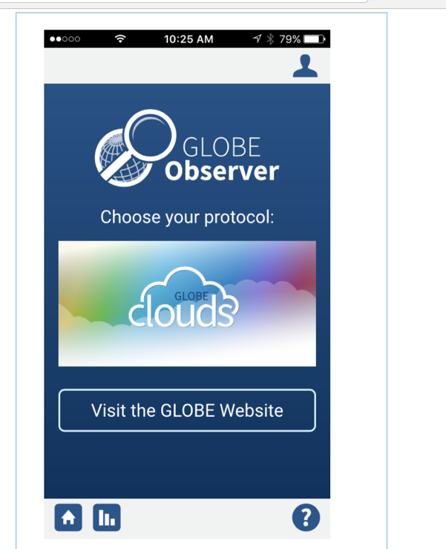
While you are waiting---
Download the GLOBE Observer App
For iOS via the App Store
For Android via Google Play
Need to register with your email address
Check email to accept the app

Slide 2
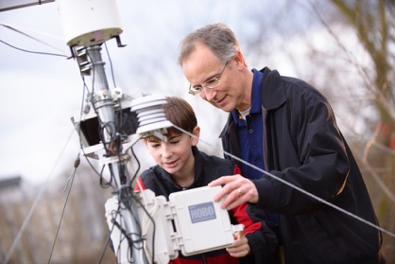
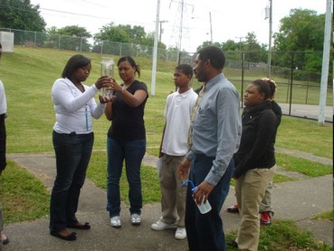
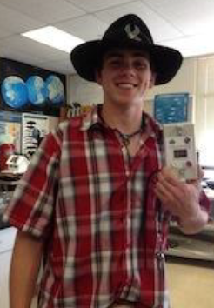
MISSION EARTH:
Students working as scientists
Kevin Czajkowski
Janet Struble
The University of Toledo
Tracy Ostrom
WestED/UC Berkley
David Padgett
Tennessee State University
www.globe.gov/web/mission-earth

Slide 3
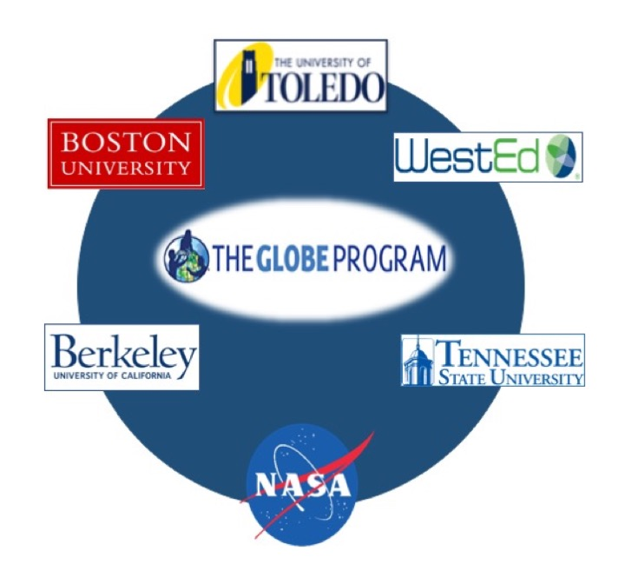
What is GLOBE Mission EARTH?
Funded by NASA
Get teachers and students to collect / submit GLOBE data and use NASA resources
Provide K-12 teacher professional development (PD)
Engage the public in using GLOBE and NASA resources
The material in this document is based upon work supported by NASA under grant award No. NNX16AC54A. Any opinions, findings, and conclusions or recommendations expressed in this material are those of author(s) and do not necessarily reflect the views of the National Aeronautics and Space Administration.

Slide 4
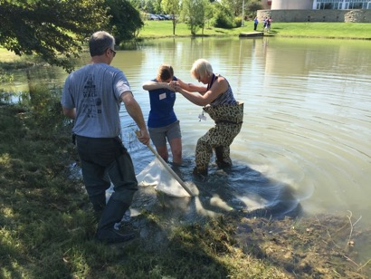
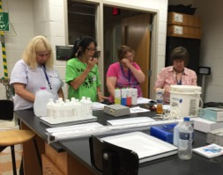
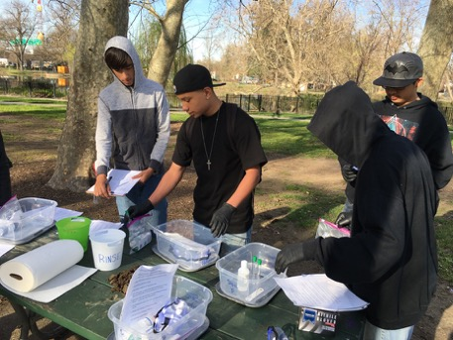
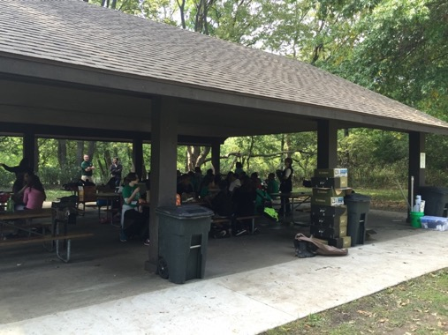
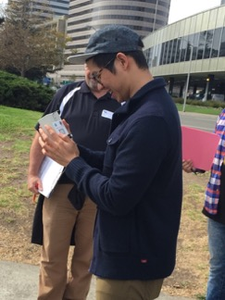
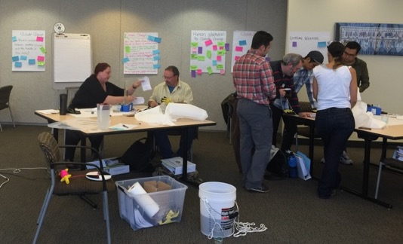
Connecting Teachers and Students to GLOBE and NASA
High School Students doing soil tests at MetSacramento
High School
Navarre Elementary testing the water from the Maumee River at Sidecut Metropark

Slide 5
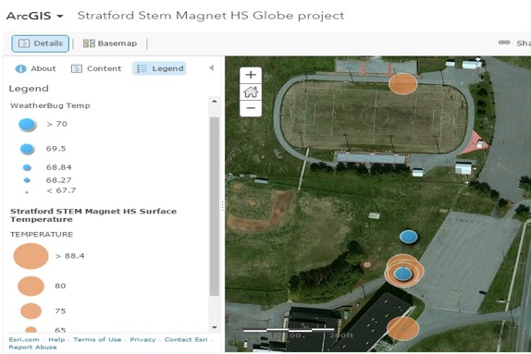
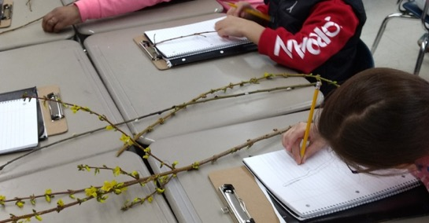
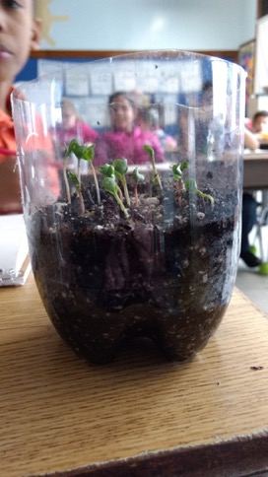
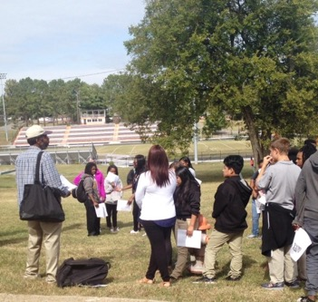
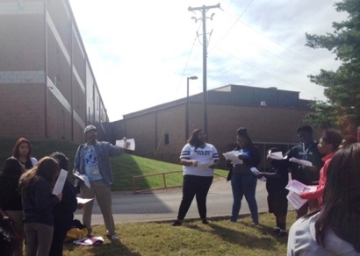
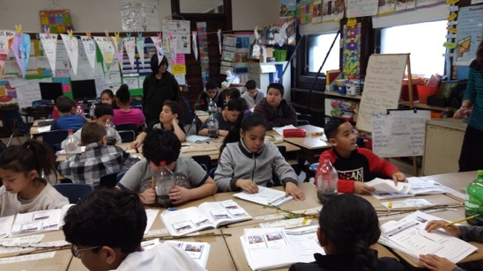
Connecting Teachers and Students to GLOBE and NASA
Elementary GLOBE: Plant Life Cycles & Bud Burst!
3rd Grade - Earth System in a Bottle
GLOBE Bud Burst Activities
Science Notebooks
Using Diagrams and Science Vocabulary
Bottle Biology
TSU undergraduate pre-service teachers lead 9th grade students at Stratford STEM Magnet High School in an outdoor surface temperature data collection.

Slide 6

GLOBE (http://www.globe.gov)
People all over the world collect data and submit data to GLOBE website
Studying what is happening all around the earth
Notes:
International Program
People all over the world collect data and submit the data on the GLOBE website
Study what is happening all around the world

Slide 7
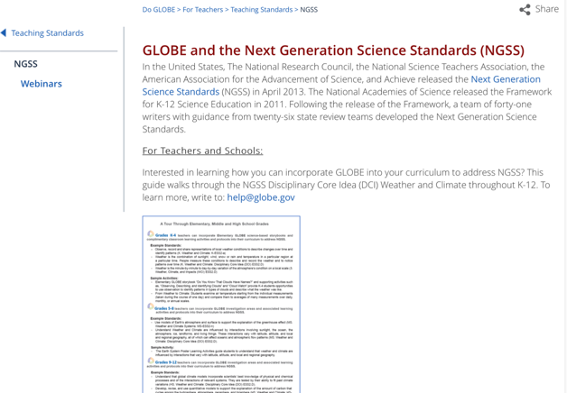
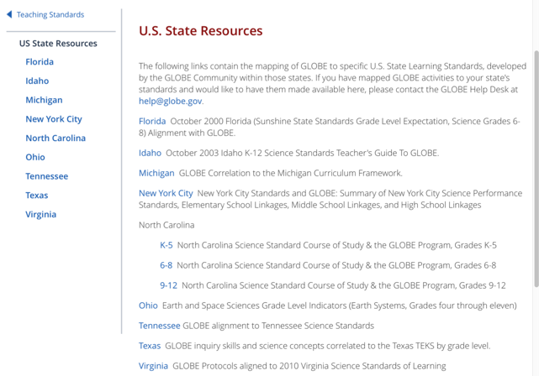
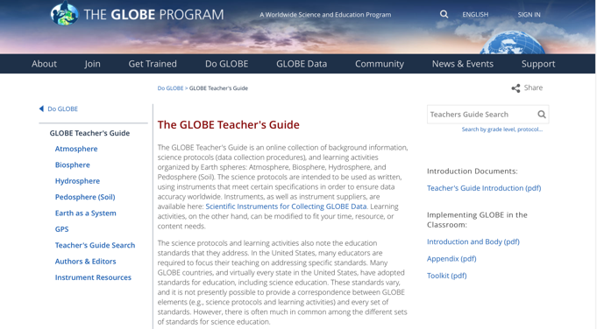

How does GLOBE fit into your curriculum?
https://www.globe.gov/do-globe/for-teachers/teaching-standards/ngss
https://www.globe.gov/do-globe/for-teachers/teaching-standards/us-state-resources
https://www.globe.gov/do-globe/globe-teachers-guide
Notes:
Look for standards webpage
Teacher Boxes

Slide 8
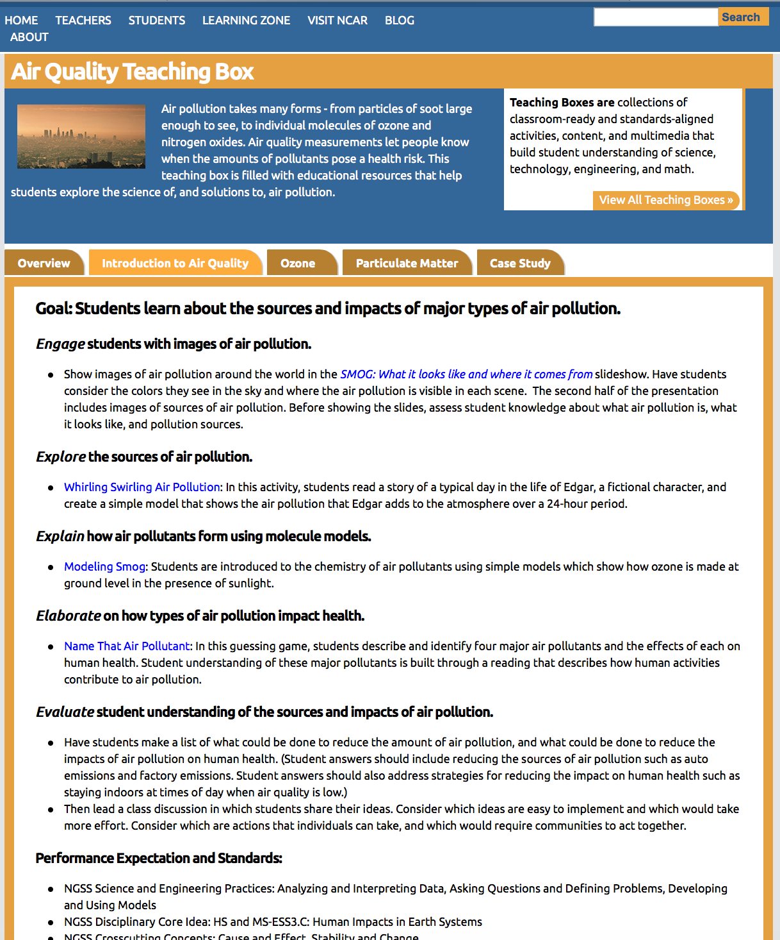
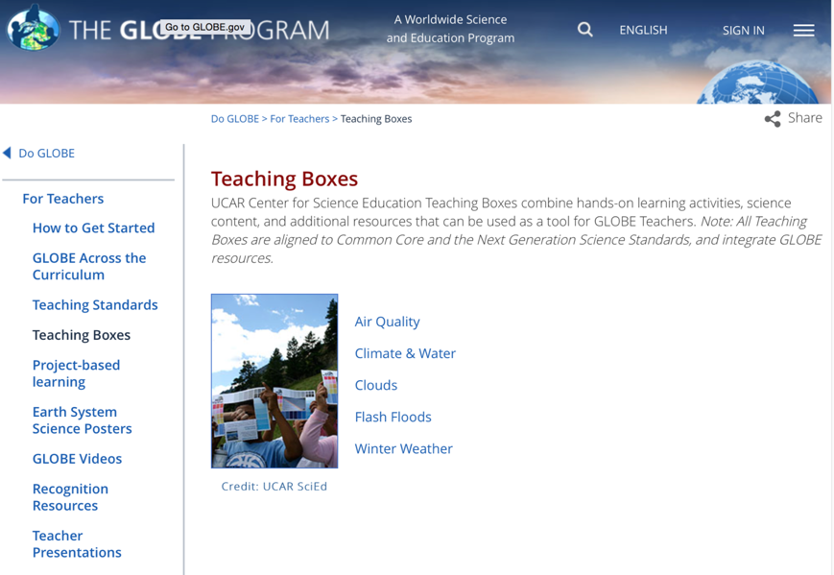
GLOBE Teacher Resources
https://www.globe.gov/do-globe/for-teachers/resources/teaching-boxes

Slide 9
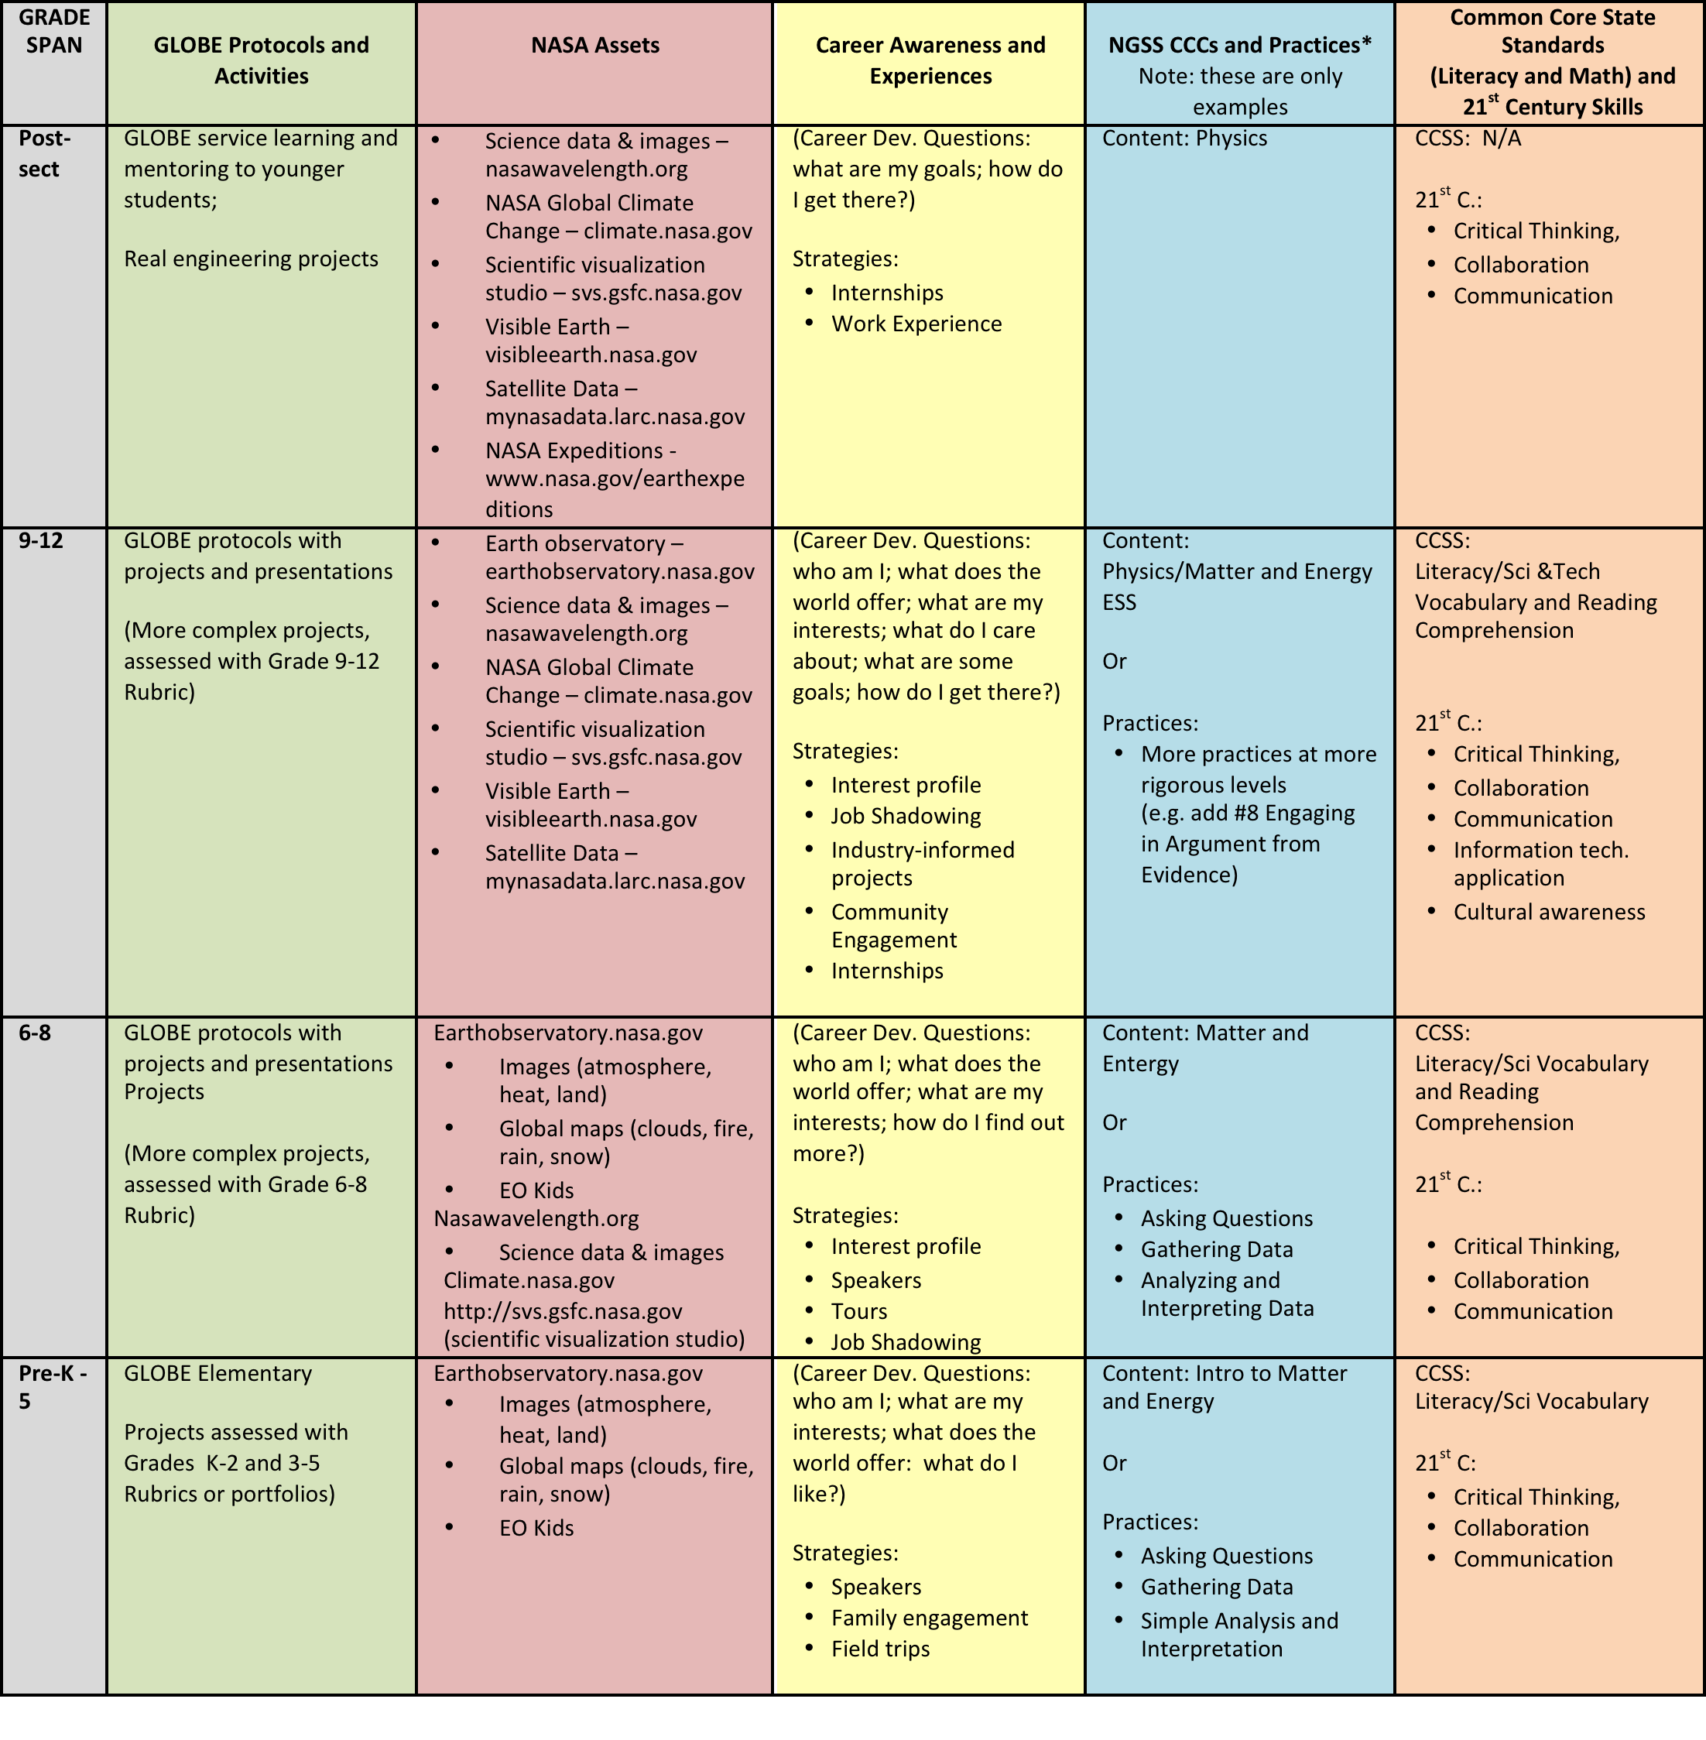
*Science and Engineering Practices
1. Asking questions and defining problems
2. Planning and carrying out investigations
3. Gathering, analyzing and interpreting data
4. Using mathematics and computational thinking
5.Constructing explanations and designing solutions
6. Developing and using models
7. Obtaining, evaluating and communicating information
8. Engaging in argument from evidence

Slide 10
GLOBE Modules
Atmosphere
Atmospheric conditions can have an important impact on the types of plants and animals that can live in a particular area as well as soil formation. The atmospheric measurements collected by GLOBE students are important to scientists studying weather, climate, land cover, phenology, ecology, biology, hydrology, and soil.
Hydrosphere
Water participates in many important natural chemical reactions and is a good solvent. Current measurement programs in many areas of the world cover only a few water bodies a few times during the year. GLOBE students provide valuable data to help fill these gaps and improve our understanding of Earth's natural waters.
Biosphere
The Biosphere is divided into natural and developed areas. All living things––including humans––depend on their habitat or land cover­­ for survival. Land cover provides shelter, food, and protection. Land cover also has a direct effect on the kinds of animals that will likely inhabit an area.
Pedosphere
Data collection of soil temperature, moisture and chemical properties is invaluable to scientists in many fields: soil scientists, hydrologists, climatologists, biologists and anthropologists.
Earth as a System
The measurements of The GLOBE Program provide students with the means to begin this exploration for themselves. GLOBE students aid in the understanding of how Earth functions as a system through data collection and student research.

Slide 11
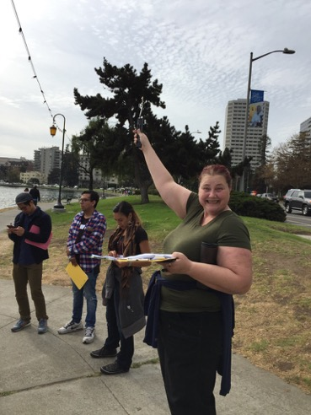
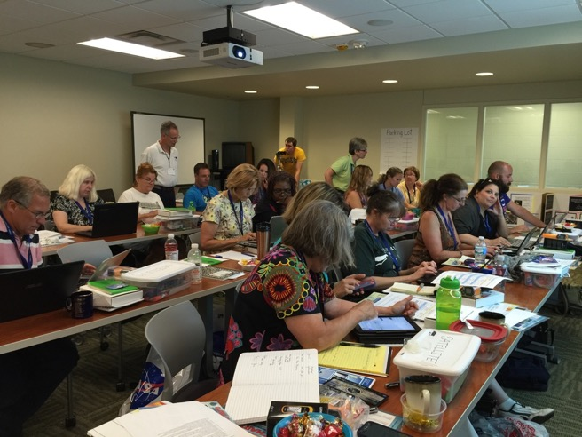
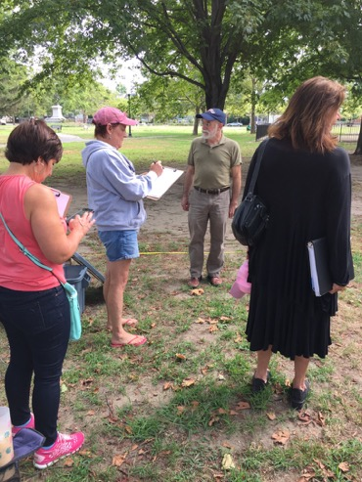
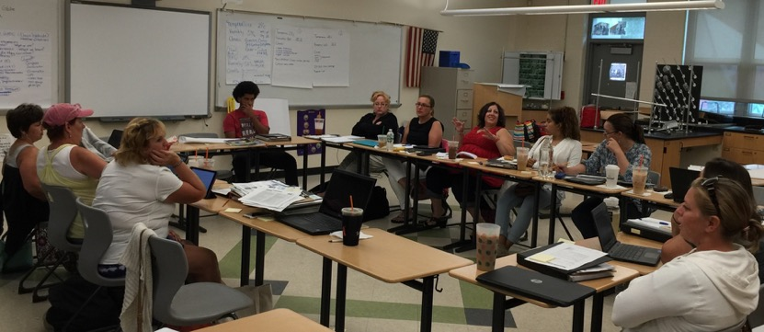
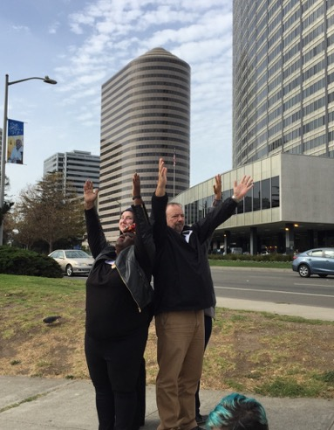
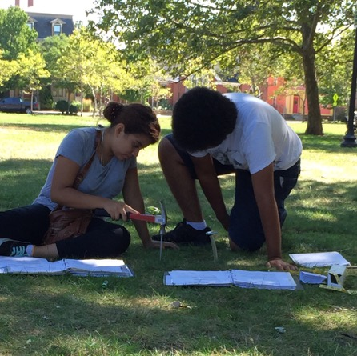
Face to Face Teacher Training

Slide 12
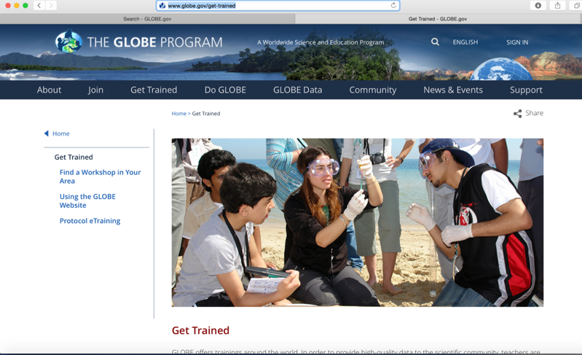
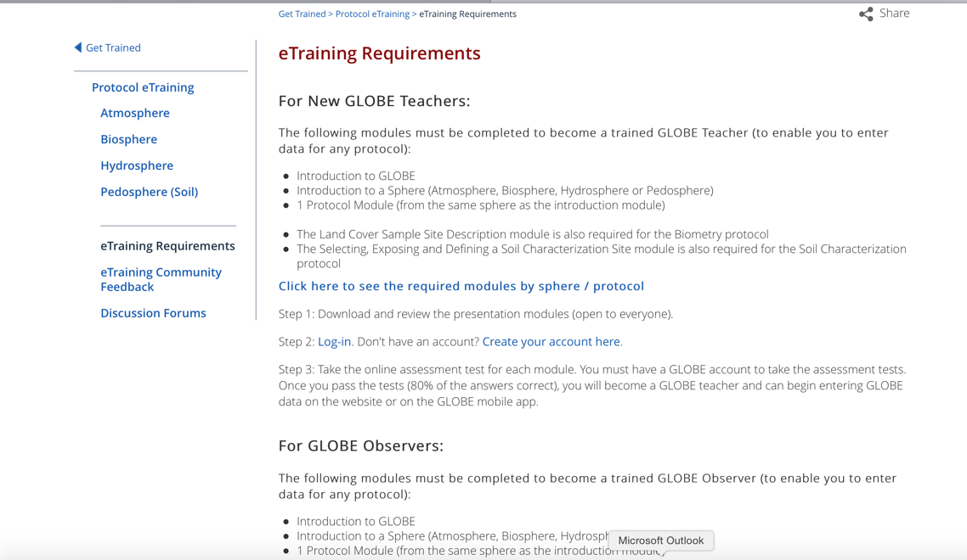
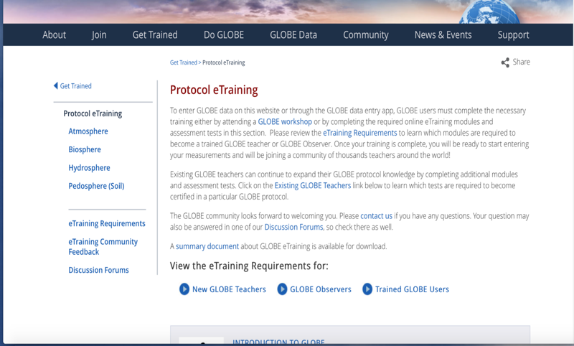
GLOBE eTraining

Slide 13
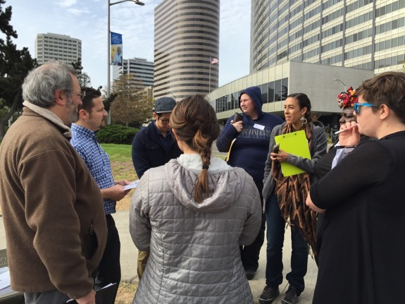
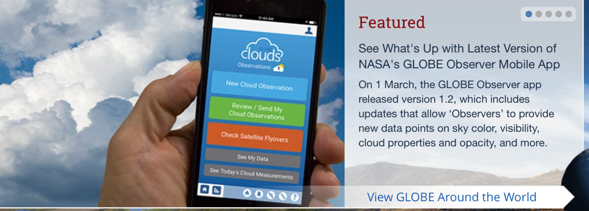
Observing Clouds-Collecting Data
Notes:
Data entry App

Slide 14
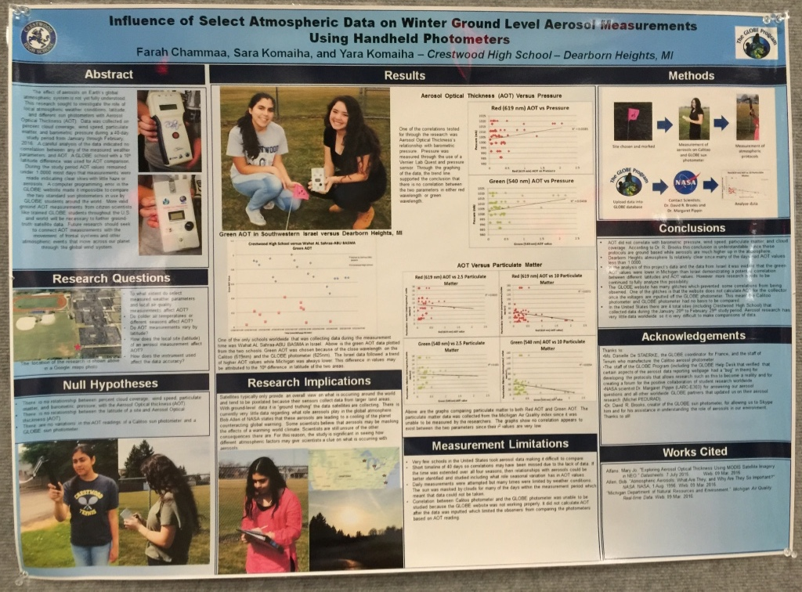
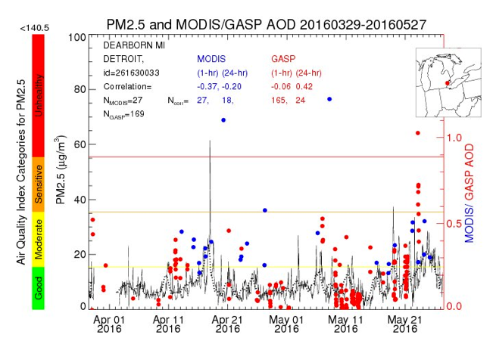
GLOBE U.S. Air Quality
Student Research Campaign
Crestwood High School Students collected data on particulates in the atmosphere.
Dr. Margaret Pippin, NASA Langley Research Center
Notes:
One Example – Students

Slide 15
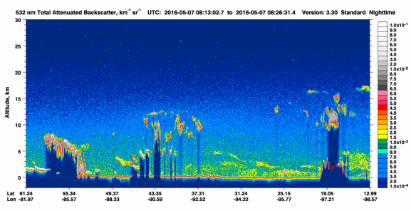
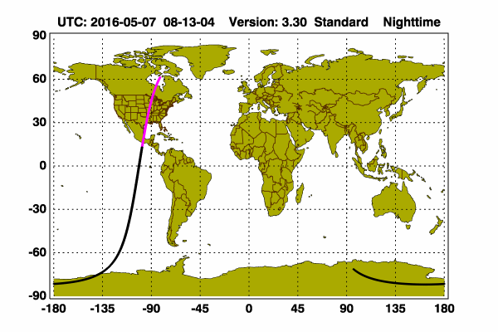
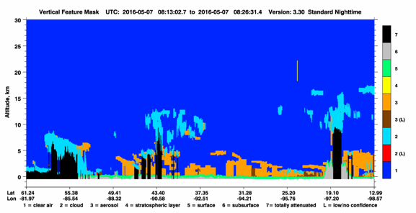
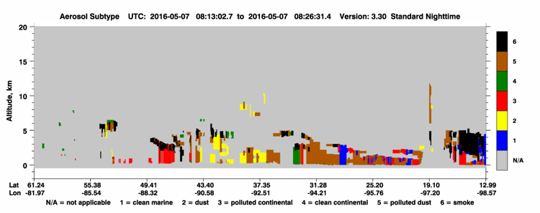
Using CALIPSO in the analysis
Students measuring aerosols can detect smoke events and use images from CALIPSO to analyze their measurements. The path of the satellite is shown in the upper left. The backscatter plots show evidence of aerosol. The vertical feature mask plot confirms aerosol aloft. Then the aerosol subtype plot confirms the aerosol is smoke.
www-calipso.larc.nasa.gov/products/lidar/browse_images/show_calendar.php

Slide 16
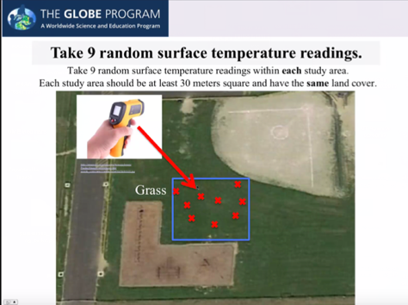
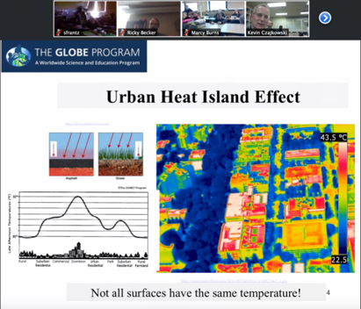
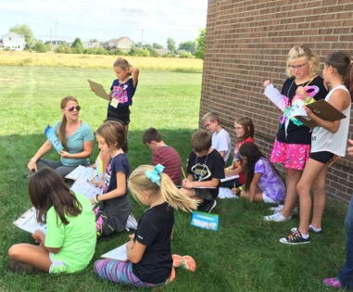
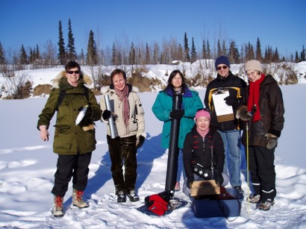
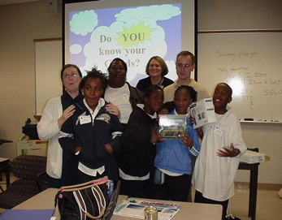
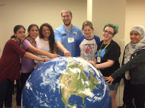
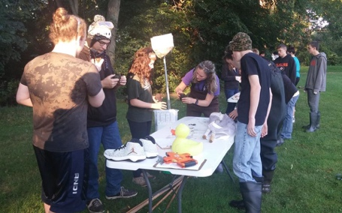
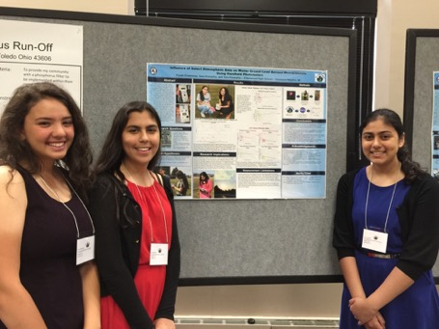
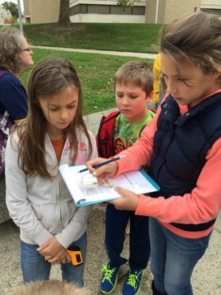
WE DO SCIENCE!

Slide 17
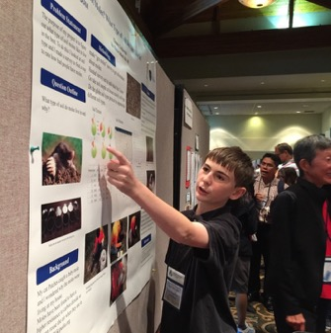




Keep the End in Mind
Students presenting their answers to their research questions
Local Science Fairs (SATELLITES Student Conference at UT)
State Science Fairs
GLOBE
Virtual Science Symposium
http://www.globe.gov/news-events/globe-events/virtual-conferences
Face to Face
Regional GLOBE Science Symposia
https://www.globe.gov/news-events/globe-events
Annual GLOBE Meeting-July 30-Aug. 4 in New Haven, CT
SATELLITES
GLOBE Annual Meeting
GLOBE Midwest Regional Symposium

Slide 18

Connecting GLOBE to Engineering Practices
Using Math & Computation Thinking
Planning & Carrying out Investigations
Obtaining, Evaluating & Communicating Information
Students using a clinometer

Slide 19







Connecting GLOBE to Careers
Grades preK-5
Grades 6-8
Grades 9-12
Conduct Informational
Interviews with
STEM
Professionals
GLOBE SCIENTIST
Kevin Czajkowski
Story Time
Internships
Create Professional Networks with Air Quality Representatives
Assemblies
METEOROLOGIST
Andrew Humphrey
Notes:
Kevin’s presentation for NASA CAN

Slide 20
GLOBE Apps (https://www.globe.gov/do-globe/apps)
SatCam
WxSat

Slide 21

GLOBE Observer App
Get the App
Need to register with your email address
Check email to accept the app
Continued in another
document

Slide 22
Thank You!
Website: http://www.globe.gov/web/mission-earth
Email: http://globe.mission.earth@gmail.com
Facebook: www.facebook.com/globemissionearth
Twitter: @globemissionear
YouTube: http:tinyurl.com/globemissionearth
Contact Information:
Dr. Kevin Czajkowski, Kevin.czajkowski@utoledo.edu
Janet Struble, Project Manager, Janet.struble2@utoledo.edu
Tracy Ostrom, tostrom@berkeley.edu
David Padgett, dpadgett@Tnstate.edu
The material in this document is based upon work supported by NASA under grant award No. NNX16AC54A. Any opinions, findings, and conclusions or recommendations expressed in this material are those of author(s) and do not necessarily reflect the views of the National Aeronautics and Space Administration.

