Slide 1
Strategies for Developing Teacher Leadership

Slide 3
INTRODUCTIONS: WHO IS IN THE ROOM?
Annie Johnston and Erin Fender
Coordinators of Public Programs
College & Career Academy Support Network (CCASN)
UC Berkeley Graduate School of Education
Stand if you:
Started your career as a Teacher
Are currently teaching
Are a Counselor
Are a Site Administrator
Are a member of the District Staff
Are a Regional or State Education Leader
Are a Coach or TA Provider
Notes:
ef

Slide 4
College and Career Academy Support Network CCASN UC Berkeley Graduate School of Education
Notes:
ef

Slide 5
About CCASN
Formed in 1998 by a group of practitioners and researchers
A secondary school reform center based at UC Berkeley Graduate School of Education
Promotes research-based practice to improve students’ preparation for college and careers through TA and coaching to support states, districts, school and teachers
Conducts practice-based research and documentation
Informs local, state and national policy
Worked in over 20 states
Notes:
ef

Slide 6
Purpose of this Workshop
Share research-based strategies that promote effective teacher leadership development
Provide resources and tools to support teacher leaders to work with their peers, with administrators, and with industry and community partners
How to delineate and distribute leadership
Identify leadership routines needed to support pathway development
Notes:
ef

Slide 7
LINKED LEARNING: A PROVEN APPROACH
Students gain career and life skills
(percentage point differences)
Source: SRI International California Linked Learning District Initiative Evaluation, 2014; executive summary, full report
Notes:
EF: Source: SRI International California Linked Learning District Initiative Evaluation, 2014; executive summary, full report

Slide 8
Why College AND Career for all Students?
Poll the room
Notes:
EF

Slide 9
WHY LINKED LEARNING
BY 2018, 63 PERCENT OF ALL U.S. JOBS WILL REQUIRE SOME EDUCATION BEYOND HIGH SCHOOL
Source: Profile of the California Partnership Academies 2009-2010, UC Berkeley (2011) http://casn.berkeley.edu/dowloads/CPA-report-execSum_2010-11.pdf
Notes:
EF: Too many California high school students are not prepared to enter today’s workforce and excel. Our economy demands workers have some sort of postsecondary or technical training. Today, 59 percent of jobs require a postsecondary credential. By 2018, this figure will grow to 63 percent of all jobs, a trend that is likely to continue to grow.

Slide 10
LINKED LEARNING: A PROVEN APPROACH
FULFILLED REQUIRED COURSEWORK FOR ADMISSION TO UC OR CSU
Source: Profile of the California Partnership Academies 2009-2010, UC Berkeley (2011) http://casn.berkeley.edu/dowloads/CPA-report-execSum_2010-11.pdf
Notes:
EF: Research shows that Linked Learning students of all demographic profiles have higher test scores and higher graduation rates than their peers at traditional high schools. In fact, 57 percent of graduates from California Partnership Academies (CPA), one type of practiced Linked Learning pathway, fulfilled the courses required for admission to UC or CSU systems compared to the state average of 36 percent.

Slide 11
FOUR COMPONETS
Rigorous academics
Career-based learning in the classroom
Work-based learning in real-world workplaces
Personalized support
Notes:
EF: Hand raise: level of experience with Linked Learning

Slide 12
Notes:
EF: This definition is drawn from the National Career Academy Coalition’s Career Academy Standards of Practice.
Together, these multiple program components comprise the College and Career Academy.
AJ: Lead teachers orchestrate this on top of teaching. Teacher leaders are most often respected by their peers for two reasons: because of their expertise in teaching, which requires tremendous dedication and commitment; and because of their aptitude for hard work, which leading an Academy most definitely is.

Slide 13
& Teacher Leaders’ Work
Relationships with Peers on the Teacher Team
Relationships with Administrators who manage school structures
Relationships with Industry and Community Partners
Notes:
AJ: In order to lead strong Academies, teacher leaders need to juggle work in three main areas, each with very specific challenges and responsibilities. More than likely, you will find my first and strongest finding, rather obvious.

Slide 14
Lead Teacher Overload
“I feel like my work load is doubled. I feel like I’m becoming an administrator…Reaching out to the community partners, monitoring internships, the budget, the paperwork. Having to go to a lot of night meetings. Getting the classes a-g approved, recruiting, providing student supports. It’s a lot of work. I’m no longer just a teacher. I feel more mid-management, but haven’t gotten the training and support.”
- Lead Teacher
Notes:
AJ: This is a serious concern for every lead teachers I’ve worked with. Yet without teachers willing to lead teacher teams to build these programs, connect to industry and post secondary partners, and work closely with site administrators to restructure schools, college and career academies cannot grow. Of the four lead teachers in this particular study in 2012-2013, only one is still teaching, and she is part time, and retiring at the end of this year.

Slide 15
Lead Teacher Overload
“We feel like we are doing two jobs. Being a pathway lead is a full time job. Being a teacher is a full time job. Having one period off from teaching just means that I have to take a full time job and fit it into five hours a week.”
- Lead Teacher
Notes:
AJ: CCASN is addressing this issue in a number of ways. In California, CCASN has worked to get legislative support for this model, the California Partnership Academies, including a mandated .2 release period for lead teachers, pure cohorts, and common prep times. CCASN has worked with model academies (“Lighthouse Academies”) to provide resources and support to developing Academies. And CCASN has developed resources to address the challenges – Master Schedule Guide share best practices, available for free on our website, which I will be introducing today.

Slide 16
Strategies for Managing Overload
Distribute leadership among team members
Build strong supportive relationships with Admin
Negotiate sufficient release time
Hold productive, effective, professional meetings
Set realistic goals, timelines and responsibilities
Notes:
AJ:What is meant by Overload – more work than can possibly be done in the time allotted.
Teachers on the team are often happier to let the lead teacher carry the load, but the load is far too heavy for one person to manage. Supportive administrators can make things a lot easier if they understand what you are trying to do and why it is in the best interests of the students. Rarely is adequate release time made available, but it is well worth fighting for. And if you can get more than one period of release time, consider sharing lead responsibilities.
The last two items are essential to building an effective team and a professional community of practice.

Slide 17
Activity: How to delineate and distribute leadership
Notes:
Pass off to Erin

Slide 18
Community of Practice Continuum
From ConnectEd: The California Center for College and Career
Notes:
EF: Lead activity
Annie: distribute COP document

Slide 19
Community of Practice Continuum
Handouts: pgs. 2 and 6 from the CoP Continuum
Read pg. 2 to better understand or learn about the idea of a CoP (3 mins)
Use pg. 6 to consider how this page might be used to: (3 mins)
Delineate Teacher Leadership
Distribute Teacher Leadership

Slide 20
Community of Practice Continuum
Discuss at your table: (5 mins)
How could the CoP Continuum be used as a guide to demarcate Teacher Leadership?
How could the CoP Continuum be used to Distribute Leadership?
How can Teacher Leaders learn to do this work with their teams?
Notes:
EF

Slide 21
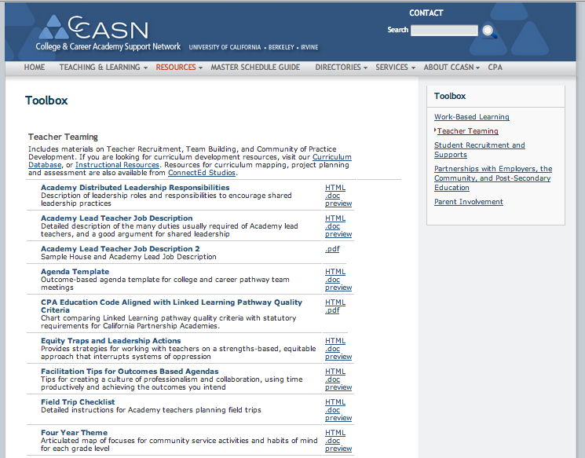
Select Resources; Toolbox; Teacher Teaming
Resources that Support these Strategies:
Distribute leadership areas among team members
Negotiate release time for lead teachers
Structure productive, effective meetings
Set goals, timelines and responsibilities
Notes:
AJ: Let’s start by looking for some tools can help you implement those strategies to manage overload.
Look at two samples and how they might be used to support each strategy..
Note that they can preview most, and that most are also offered in .doc form so they can download and adapt.

Slide 22
Working as an Interdisciplinary Team

Slide 23
Working as an Interdisciplinary Team
In lead teachers’ work with peers on interdisciplinary curriculum, the collaborative nature of the work often conflicts with the autonomous, individualistic and subject-oriented nature of teacher culture
Notes:
AJ: Building a collaborative; What is very different about this way of organizing schools.
Instructional Leadership is different. Team building key.

Slide 24
Interdisciplinary Teams
Teacher led and industry involved
Organized vertically and horizontally
Develop curriculum w/ practical applications from career filed that reinforce academic content
Create performance tasks related to the career field in both academic and CTE subjects
Use PBL approach and interdisciplinary integration
Require changes in school structures: common preps, additional planning time, cohorted student groups and carefully designed Program of Study
Notes:
AJ:

Slide 25
Integration Requires Collaboration
Single Subject
Parallel (Paired)
Interrelated
Conceptual
BASIC INTERMEDIATE COMPLEX
From Developing Multi-disciplinary Integrated Curriculum Units, by ConnectEd: California Center for College & Career
Notes:
AJ: At least half of an academy’s team time should be dedicated to improving classroom practice, for which teacher collaboration is key. Share with a table partner – what experiences have you had with any, or any combination, of these integration models? Share out. The more complex the integration, the more time it takes. Many elements must be in place to get the kind of integrated, project based, industry involved, authentic performances that represent mastery of career-specific academics and skills.

Slide 26
Searchable Curriculum Database on CCASN website
Notes:
EF: To find material you can use as a foundation for integrated curriculum, organized by industry field, go to our searchable database. This morning I conducted a workshop on how to work with the curriculum database. A powerpoint for that workshop is on the website under Resources/Articles Guides Presentations.

Slide 27
Teaching & Learning; Instructional Resources
Notes:
EF: Note BIE link, ConnectEd Studios… Have them click on the link at the end of that entry.

Slide 28
Instructional Resources: How To…
ConnectEd: California Center for College & Career
Notes:
EF: Instructional Resources is filled with How To Resources to help you design your work with the teachers on your team.

Slide 29
Supporting Students as a Team

Slide 30
Involve Teacher Team in Student Supports
Tools teachers can use to get counseling or tutoring support for students
Protocols to support teachers in managing student discipline
Sample resources for honoring student achievement
Program materials for working with students who failed to complete the class without having to repeat it
Resources Tab
Toolbox
Student Supports
Notes:
EF:

Slide 31
Increase Parent Involvement
Sample resources for involving parents in decision making for the Pathway
Documents aimed at involving parents in the school
And soliciting parent input in their child’s education (required under LCFF)
Notes:
EF: Parent involvement can offer tremendous benefits to College and Career Academies
Go to Resources Tab: Toolbox: Parent Involvement

Slide 32
Other Guides: Under Resources Tab
Notes:
EF: The more resources you have for building your college and career academy program, the better you will be able to educate your administrators, whom you need as supporters and partners in transforming teaching and learning. These handbooks will also help you distribute responsibilities among your team. Get one team member a release period to run the internship program for your juniors, get another one to sit on the Advisory Board with your industry partners. The teacher who wants to create a senior class that gets college credit needs to know about dual enrollment.

Slide 33
Administrators’ Role in Developing Teacher Leadership

Slide 34
Relationships between Teachers and Administrators
Traditionally “us” and “them”
Administrators also overloaded, trying to keep the plane in the air and all the passengers in their seats
Teacher teams are trying to rebuilding the plane dramatically -- while it is in the air
How can Administrators lead this change process?
What role can districts play in developing administrators as leaders of leaders?
Notes:
AJ: The plane is built for departments and you want time for teachers to meet across departments.
The plane is built to send students to college or work (or not), but you want them all to go on to some kind of post-secondary option.
The plane is built with assembly-line structures, in which specialized teachers pour in specific chunks of knowledge but you want the teachers to collaborate across disciplines, integrate and apply those lessons to real world situations, with the participation and involvement of community, industry and post-secondary partners.

Slide 35
Strategy: Build Strong Relationships between Pathway Leads and Administrators
“The most effective way has been for us to – I know this term sounds awful, but to band together. Like all of the academy directors, stop by his office at this day and time and say this is essential.”
- Lead Teacher
Notes:
AJ: SUPPORT lead teacher collaboration, provide places for them to engage with both administrators and other teacher leaders, such as department leads, head counselors, special education leads, ELL program leads.

Slide 36
CHANGES IN WORK ROLES require NEW SKILLS
Expectations of teachers’ instructional practice
Expectations of teacher leadership re: collaborative teaming, student support, and work with industry
Demands on site administrators
To make time in the day for pathway work
To reorganize the structures of schooling to support pathways
To support and facilitate the work of multiple pathway teams, each with industry partnerships
Site Leadership = Developing teacher leadership
Notes:
AJ

Slide 37
Reconceptualizing Admin Leadership Roles
Leaders of Leaders: “Distributed leadership”
Building leadership capacity of teacher leaders and of teacher teams
Revising leadership structures and processes
Developing a Linked Learning vision for school-wide communities of practice
Developing teacher instructional leadership within and across pathway teams and departments

Slide 38
School-wide Distribution of Leadership
Research finding: Where lead teachers could participate with department chairs and program heads in transparent, collaborative decision making, they were better able to encourage a collaborative school culture, transform instructional practices and equitably allocate resources. They influenced teachers throughout their schools.
Notes:
AJ: In the comprehensive high school, Department Chairs are the traditional leadership structure, and the traditional locus for school wide academic decision making.
Including pathway leadership in a representative teacher leadership body is essential to facilitate the kind of dialogue necessary to make broad changes in instructional practices.
Erin: Example

Slide 39
HIGH LEVERAGE: Routines and Tools
Master Schedule:
“All the academies really need support around master scheduling and cohorting our students. It is the backbone. It’s the life blood of a pathway model working. It’s so hard to do any of the real integrated curriculum when you don’t have pure classes or when you don’t have cohorted students.”
- Lead Teacher
Notes:
ERIN: Develop a collaborative approach to the master schedule.

Slide 40
Tools for Bridging the Divide
Notes:
That is why the master schedule is so essential. It’s calendar is very different from the academic calendar teachers are familiar with. By October, the courses that will be offered the following year must be in development. By December, next year’s program has to be submitted to the district. By March, all the materials are printed and being used to inform and recruit new students. In a comprehensive school, everything done in one program affects what can be offered outside that program. Career Academies often begin as a single alternative within a big school with one section per grade, but increasing to many such small programs is a disaster for the master schedule.

Slide 41
Master Schedule Guide
Notes:
Open up the sections by clicking on the plus sign. See the powerpoint for an overview of the stage.
Check out the Resources for use during each Stage on the right hand side.

Slide 42
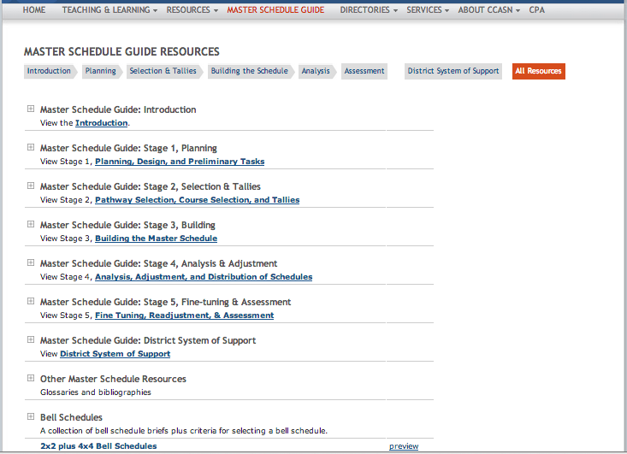
You want to build teacher collaboration time into the bell schedule….
Go to Master Schedule Guide
All Resources
Scroll Down to Bell Schedules
Explore the Options
Notes:
This guide is full invaluable tools that can help you and your administrators make the changes in school structures required to support interdisciplinary teams of teachers creating college and career academies.
Includes Excel Tools

Slide 43
Moment to Reflect: Stories from the Field for the new guide on Teacher Leadership
Notes:
EF

Slide 44
Leadership to Develop the Career-Classroom Connection

Slide 45
Relationships with Industry and Community Partners
Facilitate relevance and integration of the career theme
Access new resources and opportunities for students and teachers (intern/externships)
Challenge segregation of academic and CTE education
Champions for your Pathway
Understand and likely use distributed leadership
Notes:
AJ: Although comprehensive school site administrators were often unaware of these partnerships, and rarely included them in the school vision’s or program, these relationships were invaluable. The district put considerable resources into building these connections, which the lead teachers found incredibly helpful. And because the district prioritized these relationships, site administrators began to recognize their value. This made it easier to schedule classes so that students could access internships, launch school-wide events like career days, and industry partners felt more recognized and connected to the school, so they increased their involvement.

Slide 46
Resources for Building Partnerships
Linked Learning Pathways prepare all students to pursue post-secondary opportunities through
Exploration and preparation in career fields, and
Rigorous academic and career technical coursework related to those fields.
Notes:
AJ: The heart of college and career academy programs is building in both planning for and access to post secondary education, and work-based learning experiences, which span a continuum from Career Awareness and Exploration through Career Practicums and Preparation.

Slide 47
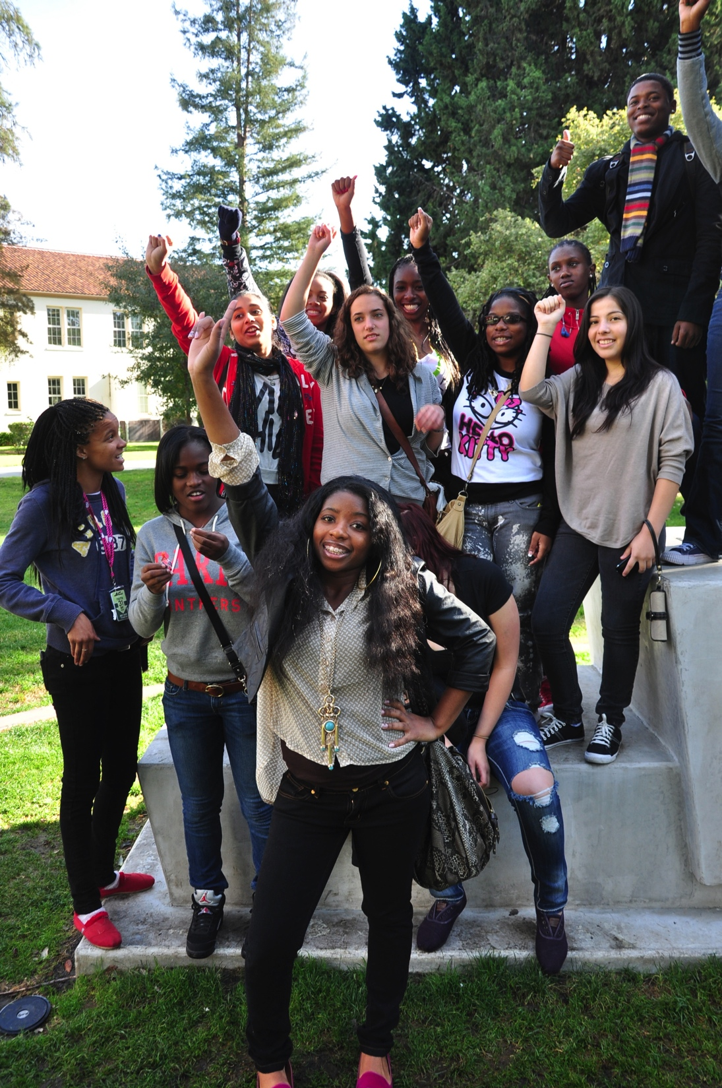
Scroll Down: Creating a College-Going Culture
Notes:
AJ: Redefining the term college. Lifelong learning. Identify a career you are interested in, learn about the options for jobs in that field, and what kind of education will be needed to access those jobs, get a solid foundation in the fundamental skills, language, ethical issues, tools, and core knowledge needed for any job in that, or related fields. Meet, job shadow professionals, learn about the performance expectations of the industry and get experience with the skills needed to meet those industry standards. Experience work in the field, both to ensure a fit between student strengths and direction, and to provide a foundation for future work in the field. College and Career preparation are closely linked.

Slide 48
Creating Work-Based Learning Opportunities
Notes:
AJ: Under Resources, go to the Toolbox and Open Work-Based Learning.
Discuss at your table: Is there anything missing here that would be useful to you?

Slide 49
Templates, Samples to Develop Partnerships
For example:
An activity to motivate students to make post-secondary plans
Samples aimed at involving employers as partners
Tools to help teachers prepare students for college and career
Notes:
AJ: Look in the Toolbox, under Resources, and open up Partnerships section.

Slide 50
In Summary
Research-based strategies that mitigate overload
Just because you are the Lead doesn’t mean you have to do everything. Distribute among team members
Build strong relationships with Admin
Sufficient release time for the Lead and the Team
Hold productive, effective, professional meetings
Set realistic goals, timelines and responsibilities
Notes:
AJ: Teacher leadership has to be supported and developed – PD to develop the capacity to build capacity to engage with industry partners, how to organize a team, facilitate a meeting.

Slide 51
In Summary
Research-based strategies that promote effective teacher leadership
Coaching and PD to support
Capacity to build relationships with Industry partners and community members
How to organize a team
Facilitating a meeting of peers
Using data for decision-making
Role of Site Administrators
Be a leader of leaders. Not us and them.
Develop structures and strategies to engage with teachers to get and give info/feedback
Notes:
AJ: Teacher leadership has to be supported and developed – PD to develop the capacity to build capacity to engage with industry partners, how to organize a team, facilitate a meeting.

Slide 52
In Summary
Resources and Tools to support Teacher Leaders (so your not re-inventing the wheel) from ConnectEd
Community of Practice Continuum
Designing Multidisciplinary Integrated Units Guide
WBL Guide and Toolbox
Pathway Guide
Curriculum Mapping Tool
Rubric Bank
Design a Performance Task
Create a Project
Notes:
EF

Slide 53
In Summary
Resources and Tools to support Teacher Leaders (so your not re-inventing the wheel) from CCASN
Toolbox
Teacher Teaming
WBL
Partnerships w/ Employers, the Community and Post-secondary Ed
Student Recruitment and Supports
Parental Involvement
Curriculum Database
Instructional Resources Tab
PBL, WBL, Assessments and Rubrics, UC a-g approval
Guides (Externships, Partnerships, Internships)
Online Master Schedule Guide
Notes:
EF

Slide 54
QUESTIONS?
Notes:
EF

Slide 55
LINKEDLEARNING.ORG
Notes:
For more information and resources visit LinkedLearning.org

