Slide 1
Section Tally and Staffing Instructions
The Section Tally and Staffing tool is designed to support the building stage of the master scheduling process and will:
Helps you keep the master scheduling process organized
Help you keep track of the section count for cohorts, departments and school wide
Helps you decide where you can cut (or add) sections to stay within your allocation
Helps you determine the number of seats per grade to count for sections with students from various grades
Helps you keep track of your staffing allocation
The Section Tally and Staffing tool is an Excel workbook consisting of inter-related spreadsheets on tabs. You are able to utilize this workbook to organize your section allocations by Academies, Departments or any combination of sections that works for you. This tool has evolved since its inception in the early 1980’s and has served its purpose admirably. Some day, your student information system will incorporate the elements of this tool so its use will become obsolete, but this hasn’t happened over the past 30 plus years, so don’t hold your breathe. Please contact us at the College & Career Academy Support Network if you have questions. Thank You.
Happy Scheduling!!
http://ccasn.berkeley.edu/

Slide 2
Spreadsheet Layout
The Section Tally and Staffing workbook is organized into twenty-two inter-related spreadsheets on tabs (don’t get too nervous – 20 of the spreadsheet tabs are identical so once you learn to use one, you know how to use all 20...and their use is optional). When you first open the spreadsheet, it will open to the tab labeled “Tally”. Below is a much reduced image of the uppermost portion of the “Tally” tab.
1
The “Tally” tab spreadsheet is divided into three main sections:
1 – Initial Data Input & Summary Information
2 – Course and Staff Input Sections (showing 1 of 20 sections – space for 876 different courses)
3 – Staffing Allocation Section
(showing 4 of 13 columns used to input staffing data – space for 650 individual staff members)
3
2
19 additional, identical course input sections follow below

Slide 3
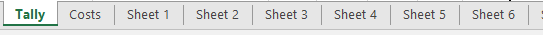
Teacher Section
Assignment Sheets
Here you see a portion of one of the 20 teacher assignment sheets – labeled Sheet 1 through Sheet 20 on the tabs at the bottom of the workbook (the entire set of spreadsheets of Section Tally and Staffing tool). These sheets are very helpful when assigning sections to teachers. They automatically list the information you input on the Course and Staff Input Sections. A complete description of the use of these sheets comes a bit later. Just wanted you to see it for orientation purposes.
Portion of tab listing at the bottom of the Excel Workbook

Slide 4
When you open the spreadsheet, this is what you will see. Throughout the entire tool, make entries only in cells highlighted in yellow. Begin by filling in the information in these 11 highlighted cells.
Special Note: All cells with formulas (and there are 366,819 of them) are locked, but not hidden, so they can be viewed. This enables one to learn how this tool works while insuring that a formula is not accidentally deleted.

Slide 5
Next move to the right across the spreadsheet to the cell blocks starting by cell BB9. You will see two blocks of cells for entering additional staffing allocations. For demonstration purposes, the blocks here have been filled in with examples; the blocks on the spreadsheet you begin with will be blank.
If you are provided additional staffing enter it here as a decimal fraction of a full time teacher equivalent (FTE)
If you are provided periods of ROP support, enter it here as the number of periods of support.

Slide 6
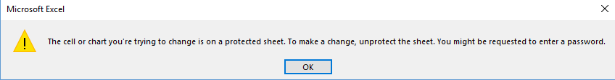
Don’t worry if you see this!!
If you happen to browse this spreadsheet before you enter any of the setup information, you will see many, many cells that look like those shown below. Don’t worry, all of this disappears as soon as you enter the setup information.
If you click on a cell with a formula and try to enter information, you will get the message shown below. The cells with formulas are locked so you can’t accidentally delete them, but they are visible so you can see what the formulas do. Just click on “OK” to continue working.

Slide 7
The area between columns A through AG and rows 16 through 78 provide summary information after student course request information is entered. Let’s take a look at each area to see the information provided.

Slide 8
This is an example of with the initial information filled in. Only cells highlighted in “YELLOW” are filled in by you. The “Staffing Allocation Divisor” is a calculated value. Divide the “Estimated Total General Fund Enrollment” by the “Staffing Allocation Divisor” and the result will be the “Staffing Allocation.” The “Staffing Allocation Divisor is calculated simply by dividing the “Estimated Total General Fund Enrollment” by the “Staffing Allocation.” Go ahead and do the division – 2500 divided by 87 = 28.7356. This would be the average number of students in each section of class if teachers teach the same number of classes as students take. Let’s go to the next slide to see the real average class size for this example.

Slide 9
Beginning at cell C16 you will see this set of information – all calculated from the initial information you entered. Here you see that 3.6 additional FTE is shown. You see the “Staffing Allocation” of 28.73563218 (accuracy beyond necessity-sorry), the number of “Student Periods” (6), and the number of “Teacher Periods” (5) and a listing of various “Divisors.” The first “Divisor” is 34.483 – this is the real average class size when the difference in teacher periods and student periods is taken into consideration. To calculate this number, multiply the “Staffing Allocation” (28.7356…) by the number of student periods (6), and divide the result by the number of teacher periods (5). The “Divisors” are used to help you determine the number of sections to allocate for each course in the master schedule. You will see this after a few more slides.

Slide 10
Beginning at cell B31, you will see the information shown below. This chart tabulates all the entries made in the “Course Input Sections” (you will see these in just a bit) and provides a status report on utilization of the sections and FTE you have to allocate. Here you see that 37 sections have been assigned, but 5 of the sections have not been allocated to a teacher. The sections “at of above Average” and “below Average” can be quite helpful when balancing the number of sections allocated.
This value comes from the Teacher Input section that we will look at later.

Slide 11
The chart beginning at cell B43 is simply a concise status summary. The message, “You have sections to add” will change to “Need to cut sections or add FTE” or “Perfect FTE Allocation – Good Job!!” depending on the allocation balance.

Slide 12
The chart beginning at cell L14 provides a summary of the Student Counts by “Course Input Section.” Here you see that counts have been entered in 2 Course Input sections. Blue highlighted text are hyperlinks to individual Course Input Sections. The titles of the Couse Input Sections can be changed to whatever you wish at the beginning of each Course Input Section. Click on the hyperlink to go to the title at the top of each section and change it to whatever you want. The numbers to the left of each Course Input Section lists the number of staff members and courses that can be listed in that Section. Notice Input Section #18 with space for 90 teachers and 100 courses. Some small schools just use this section for their entire school.
Enter the grade levels you want to appear throughout this spreadsheet here

Slide 13
Beginning at cell U17 is a summary chart based on seat counts. This is just another way of looking at the data entered.

Slide 14
The chart that begins at cell C52 provides a summary of the number of sections assigned by Course Input Section and what is needed to have everything in balance. Here you see that 49 sections have been assigned in the Green Academy and 4 more sections need to be assigned to teachers. This represents 0.8 FTE in this example.

Slide 15
The chart that begins to the right of cell N53 is a count of all Singletons, Doubletons and Tripletons sections allocated in the Course Input Sections. Since the Green Academy section is the only one entered in this example, you see only those counts. Once all sections have been entered, a very interesting assessment of your master schedule immerges.

Slide 16
All of the Course Input sections below row 84 are identical in format, but vary slightly is capacity. I will explain on the next slide. Remember, only areas highlighted in yellow are for input. Let’s begin by identifying these areas:
4-Course Duration:
1= Full Year Course
2= Course offered 2 times per school year
3= Course offered 3 times per school year
4= Course offered 4 times per school year
1-Title
(change to anything you desire)
2-Course Number
3-Course Title
6-Course Tallies by Grade (Enter this information before entering anything in the Number of Sections area)
8- Number of sections taught within this Course Input area by each teacher listed
5-Number of Sections area
7- Teacher Names

Slide 17
Variations in the Course Input Sections
As mentioned previously, there are 20 Course Input sections (below cell L14 and shown in this set of instructions on slide 12). These can be used to organize your master schedule by academies, departments or any way that is convenient for you. In these sections you list courses, the number of sections of each course, the teachers who will be teaching the sections and the number of sections each teacher will be teaching. The format of all Input Sections is identical, but 3 of them vary in the number of courses that can be listed and the number of teachers that can be listed. Sections 1-17 all have input spaces for 40 courses and 36 teachers. Section 18 has input spaces for 100 courses and 90 teachers. If you have need to combine a large number of courses and/or teachers in one section, this is the section for you. Also, a small school may wish to just use this section for the entire school. Section 19 has been set up for the Resource student courses and has spaces for 48 courses and 36 teachers. Section 20 is set up for the Special Education student courses and also has spaces for 48 courses and 36 teachers.

Slide 18
A special note on course and student course request input
Student information systems vary greatly in their ability to export data. If you are able to export the student course request tally summary into Excel format, you will be able to copy from your export directly into this portion of the Section Tally and Staffing spreadsheet. You may need to sort your export so courses are in your desired order and you may need modify your export so these 6 needed columns are adjacent to each other for copying and pasting.
The values that are placed here are the actual course request counts by grade level for each course. In this example you see Course # “5618”, Course Title “Ceramics”, 123 grade 9 student requests, 155 grade 10 student requests, 59 grade 11 student requests and 47 grade 12 student requests. The total of 384 student requests is automatically calculated.

Slide 19
Here the full rows of the Course Input section have been divided into two parts so all of the rows can be seen at once. Notice that when student course request counts are entered (here 215 grade 10 students, 163 grade 11 students and 5 grade 12 students) other values are calculated and appear in the row.
With a total of 383 students requesting this year-long course, this area shows you the number of sections needed at various class size levels. For example, to keep the class size at 35 students, 11 sections are needed.
Same cell
The next step is to enter a tentative number of sections to allocate to this course.

Slide 20
This is just the right side portion of the Course Input section. When a section count number is entered, there are additional calculations displayed to the right.
Here, 11 sections have been entered as a tentative section allocation count for this course.
Given 11 sections, the average class size will be 34.82 (AVG column), if you reduce the number of sections to 10 (AVG<1 column), the class size average will be 38.30, if you increase the number of sections to 12 (AVG>1 column), the class size average will be 31.92
This “Class Averages” section is very useful when you have completely finished entering all courses and the tentative number of sections to allocate to each. If you have room to add sections or if you need to reduce the number of sections to meet the staffing allocation, you can easily see where adjustments can be made.
The Splits are most helpful when counting the number of seats by period by grade level in the master scheduling process. This is especially helpful when balancing classes. The splits are proportionately calculated based on the number of sections assigned and the student course requests by grade level.

Slide 21
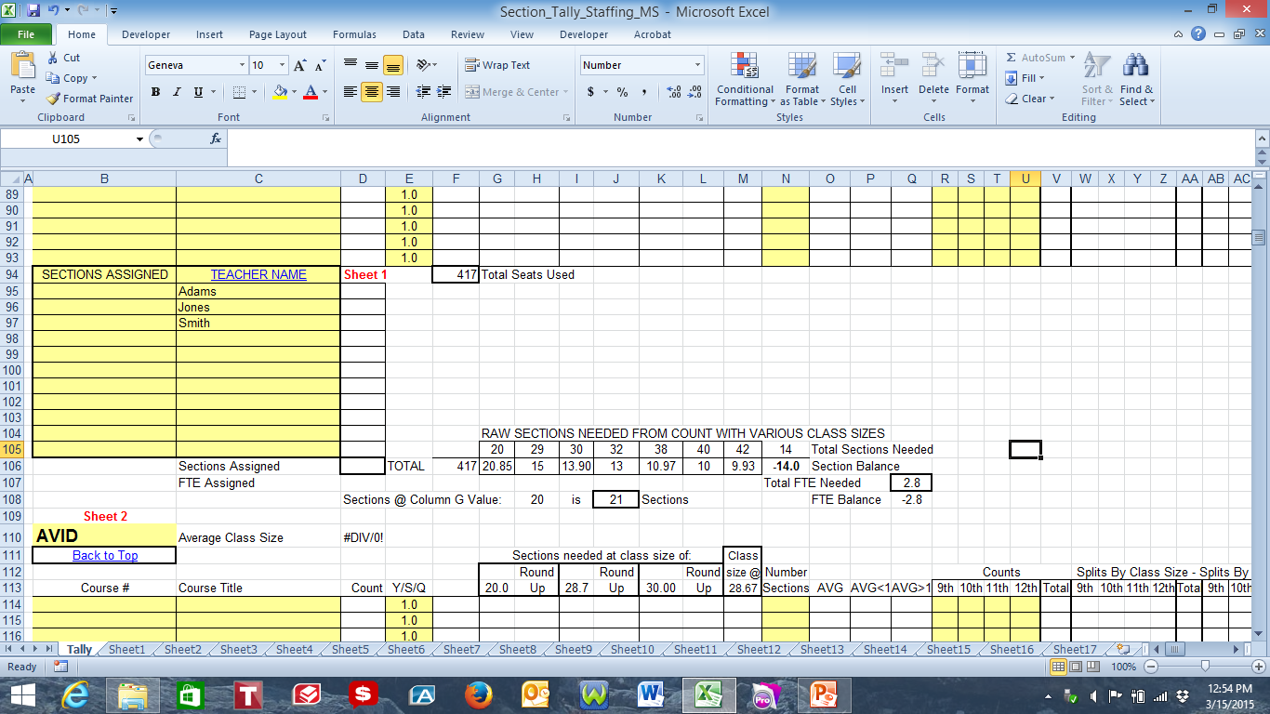
Teacher Assignments
The next section to fill out is the Teacher Assignment section. Here the names of teachers are entered. If it is fairly straight forward and you know exactly how many sections each teacher will teach in this particular Course Input area, go ahead and enter the number of sections adjacent to each teacher’s name in the “Sections Assigned” column (column B). If it is not so straight forward and you need to do some figuring about just how many sections each teacher will take, I have provided a place to do the figuring. Look at the bottom of the Excel spreadsheet. You will see a row of tabs. The first is labeled “Tally” and then “Sheet 1” through “Sheet 20”. Each Course Input section is associated with one sheet - in this example, Sheet 1. Click on any of the “Sheet_” hyperlinks or the “Sheet_” tab at the bottom of the spreadsheet to get to the “Teacher Section Assignment” sheet for each Course Input area.
Note: An individual teacher can be entered into several Course Input areas, just make sure the teacher’s name is identically entered each time.

Slide 22
This is an example of a Sheet – The Teacher Names, Course Titles and Sections Needed automatically appear.
An indication of areas that need a “FIX” are also indicated. Here, since 14 sections of Health and Career Education are needed and “0” are assigned, there need to be a FIX.
Go to the next slide for the FIX

Slide 23
Here 5 sections have been given to Adams, 5 to Jones and 4 to Smith. This balances the need for 14 sections and all of the FIX issues have been taken care of.
Let’s look at a more complicated area

Slide 24
This is just a portion of the listing of the classes from the Science area. By assigning sections of the various courses to teachers, the total sections needed and the total sections assigned to each teacher is tabulated. Here you see that teacher Streisand is assigned to a total of 5 sections – 2 sections of Science 1HP, 2 sections of Science 2P, and 1 section of Science 2HP. The correct total number of sections of Science 1P, Science 1HP and Science 2P have been allocated. Two more sections of Science 2HP need to be allocated. If the rest of the Science chart was visible, you would see where a total of 26 sections need to be allocated.

Slide 25
Looking back at this sheet – since everything is balanced here, it is time to go back to the Tally sheet and you will see that the teacher’s total sections assigned is transferred there.
To go back to the Tally sheet, click on the “Back to Tally” hyperlink at the top of the page or the “Tally” tab at the bottom of the spreadsheet

Slide 26
Teacher Assignment Section
This is a reduced view of the Teacher Assignment Section. It really isn’t supposed to be read here, it’s just for orientation.
Sections transferred from “Sheet_”
Reminder Column
Sections Assigned
Teacher Names
Section Balance Chart
Teacher Balance

Slide 27
The total sections allocated by teacher appear here. These come in automatically from the “Sheet_” – Here they come from “Sheet 1”
These section counts by teacher need to be entered in the yellow highlighted “Sections Assigned” column adjacent to each teacher’s name.
If you have not entered the count in the “Sections Assigned” column, a red “X” will appear in this row.

Slide 28
The Section Balance Chart
Before you add the teacher section counts to the yellow highlighted column, this summary area shows that 14 sections are needed based on the input in the Number of Sections column.
After you add the teacher section counts to the yellow highlighted column, the summary area shows that of the 14 sections needed all have been assigned (a blank “Section Balance” cell.

Slide 29
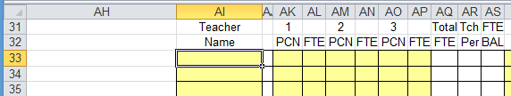
The final input section begins at cell AI33. This is where staffing allocation totals are tabulated. This area is composed of 13 identical blocks of 11 columns extending down 50 rows. This gives sufficient room to enter all teacher names with separations between names for additional entries as necessary.
Enter the teachers’ names here exactly as it has been entered in the Teacher Assignment sections.
A Position Control Number (PCN) is a unique teacher identifier based on the funding source. A full time teacher may be partially paid from the general fund and from a special grant fund which could give the teacher two PCN’s. It is very helpful to keep track of this for numerous reasons including making sure your general fund allocation is accurate.
Here is a teacher with 3 PCN’s for a total of 1 Full-Time Teacher Equivalent (FTE). The number 5 indicates that this teacher has not been assigned to any sections and can be assigned to 5 sections.

Slide 30
Here is the list of teachers as entered in the Teacher Assignment section; Adams with 5 periods, Jones with 5 periods and Smith with 2 periods. All three teachers are full time with 1 FTE. Why does the Teacher Assignment Summary show Smith as having 5 sections assigned?
The answer is the column immediately to the right of the Teacher Name column. The number in this column tells how many times this teacher’s name appears in all of the Teacher Assignment sections; Smith is listed two times. In the above listing, Smith has 2 sections. In the “Sections Assigned” listing that is not shown here, Smith is assigned 3 sections making a total of 5 sections.
This column shows the number of sections assigned to a teacher
This column shows the number of sections remaining to be assigned to a teacher based on his/her total FTE

Slide 31
If you look just above the Teacher Allocation Summary area beginning at cell AJ18, you find an overall summary of the information entered. Four teachers are listed, the FTE allocated is 67, the extra FTE is 5.4 giving a total FTE allocation of 72.4, a total of 4 FTE has been used leaving a balance of 68.4 unused FTE. The allocation in number of sections is 362, a total of 20 sections have been accounted for (4 teachers at 5 sections per teacher), there are 342 sections left to place and there are a total of 5 periods unassigned.

Slide 32
Now if you go back to the summary area between columns A through AG and rows 16 through 78 you will start to see some useful information.

Slide 33
Section Allocation Cost Analysis
If you click on the “Costs” Tab, you will see what is pictured below. The only input you have to do on this page is to fill in the “Average Yearly FTE Cost” – Everything else is automatic.
This sheet analyzes the cost of the section allocations you have entered on the Tally tab. I will explain more on the next page.

Slide 34
Once you enter the original setup on the “Tally” sheet and your “Average Yearly FTE Cost” on this sheet, all the rest of these calculations are automatically populated. Here $50,000 is used as the FTE cost, students take 7 classes, and teachers teach 6 classes. Using entries that are made on the setup of the Tally sheet and the FTE Cost here, the average cost of one period is $8,333.33. Divide this number by the maximum class size of 36 students and the result is the average cost per student - $231.48. It would be wonderful if you were able to fill every classroom to the maximum load – but I have never seen it happen. So, this sheet calculates the cost of empty seats and the savings when you can place more students in a section than the class maximum. Let’s look at the next page to see how this works.

Slide 35
Let’s do a little bit of math – don’t worry – I give all the answers too.
If the Average FTE Cost per year is $50,000 and the teacher teaches 6 classes:
$50,000 divided by 6 = $8333.33 which is the cost for each class.
If there is a full class of 36 students then $8333.33 divided by 36 = $231.48 which is the cost for each student in the class.
But, if there are only 35 students in the class (one empty seat), then $8333.33 divided by 35 = $238.10 – a slightly higher cost per student in class ($6.62 – but because of rounding the chart is going to show $6.61 in this example).
If there are 37 students in the class (one over the class maximum in this example) then $8333.33 divided by 37 = $225.23 (rounded off) which is $6.26 less per student than with a class at the maximum of 36.
This is what the “Cost” sheet calculates for all sections you have entered on the Tally sheet.
Just to give perspective, if you have 400 sections in school and the average number of students in all sections is 34 students, the extra cost in this example would be:
$8333.33 divided by 34 = $245.10 which is $13.62 more per student. If you multiply $13.62 by the 400 sections in school in this example = $5,448 (this would indicate a very good allocation of sections).

Slide 36
This is the top portion of the first section of the “Cost” sheet. There are 20 sections that correspond to the 20 Input Sections on the “Tally” page. Here you will see all the calculations that were explained on the previous page. This page also converts the dollar amounts into FTE utilization and provides and assessment of the total effect in column “Q”
I have split the display up and enlarged it so you can see the calculations.
This is the summary analysis for just this one Input Section
The rest of this chart is displayed on the next page.

Slide 37
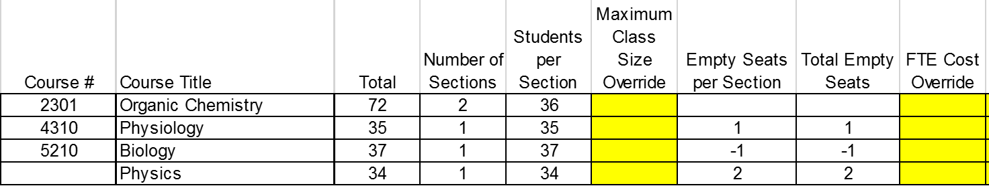
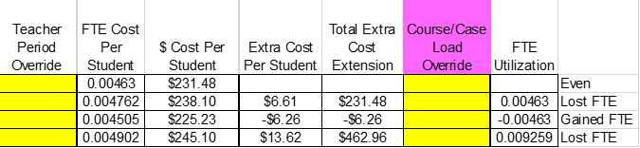
Overrides are provided if you want to use different values in your calculations.
Below are the calculations we discussed on slide 36 and here is the overall assessment for the section allocation of each course.

Slide 38
Back at the top of the “Cost” tab is a summary of each Input Section with the combined analysis at the bottom highlighted in purple. This analysis shows that this section allocation is costing an extra $14,415.77 which is 0.254630 (approximately ¼ of an FTE) and the Analysis is that there is a loss of FTE.
The “Cost” tab is designed to help site level master schedule teams see the effects of section allocation decisions and help to economize as much as possible. It is also designed to help district level decision makers see the impact of program and staffing decisions on the masters schedule. We encourage the development of master scheduling teams composed of site and district level personnel working together to develop the best possible schedule for students.

Slide 39
Now lets review of the steps to use the Section Tally and Staffing Tool
Step 1 – Fill in staffing information
Step 2 – Fill in additional staffing information

Slide 40
Step 3 – Fill in the highlighted areas for each of the Course Input sections that you will be using. The first time you do this, it may take a bit of time due to entering all the course numbers/names and the teacher names, but future years will most likely only require minor changes (this process is much easier if you can copy and paste using an export from your student information system as mentioned earlier). Enter all of the student course request counts, your best estimate of the number of sections of each course to offer. Enter the names of the Teachers that will be teaching the courses in this input area and the number of sections each teacher will teach in this input area (using the “Sheets” if needed). Once everything is entered, the summary charts will guide you to make changes if necessary.

Slide 41
A Special Note About Student Course Requests
If I were asked which area of the master scheduling process causes the most problems, I would have to say the student course requests. Issues like trying to build a master schedule without all of the students course requests being entered, late notice of district transfers, decisions about which courses to offer, correction of course request entry errors, and differences between staffing allocation and the apparent staffing need based on the student course requests are all common. Since the request counts from the student course request are the basis for building the master schedule, it is critical to get this correct. As a recommendation, begin collecting course requests from students as soon as possible after the beginning of the last grading term of the school year – usually the beginning of the second semester. Once you have entered the data, share the Student Course Request Tally Summary with anyone who will look at it. The more eyes the better to find mistakes and make decisions about things like which courses to offer, which courses to combine and the number of sections of each course to offer. Make corrections to the student course requests and print another iteration of the Student Course Request Tally Summary. Then go through the vetting process again. I have gone through dozens of iterations of the Student Course Request Tally Summary just to get it right. Just a word to the wise.

Slide 42
Step 4 – Enter the teacher names in the Staffing Summary area exactly the same as they were entered in the Teacher Assignment section. It is not necessary to enter PCN’s, just sometimes convenient. But be sure to enter the FTE for each teacher. List teachers here only once. This section will tell you how many places a teacher’s name appears throughout the Teacher Assignment sections in the column immediately to the right of the teacher’s name. Review the summary totals and make staffing and section allocation adjustments as necessary.

Slide 43
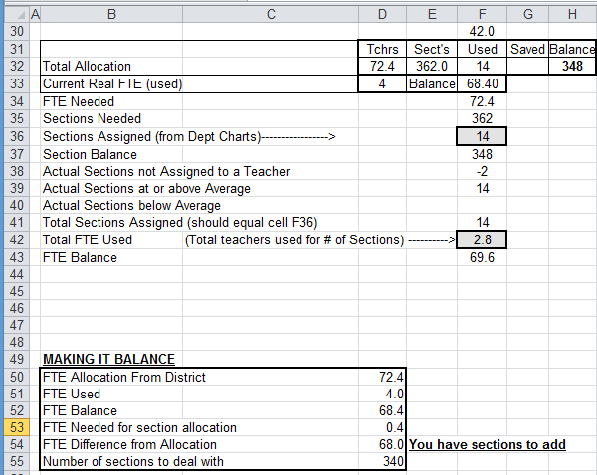
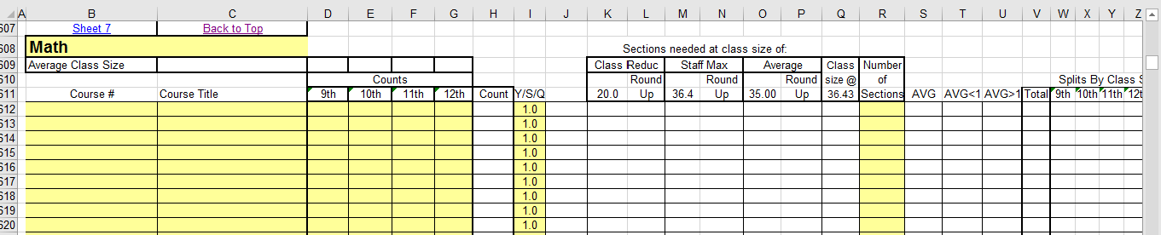
Step 5 – Review the numbers in the summary charts. Adjust the number of sections allocated in the “R” column of the Course Input areas until FTE allocation is balanced; equal to zero (a zero balance cell will show as blank – zeros have been suppressed)
Watch these cells as you adjust the section counts in the “R” column. These now show that 348 sections remain to be assigned.
The “R” column

Slide 44
The adjustments you will be making to balance the staffing allocation are:
Section allocations in the “R” column of the Course Input areas
Teacher section counts in column “B” of the Teacher Assignment section
Now you are ready to set up your section and staffing allocations. Be sure to include the entire master scheduling team, cohort/team leaders, department chairs and any other interested staff throughout this process. If you have any questions or need assistance, don’t hesitate to contact us at the College & Career Academy Support Network (CCASN) at http://casn.berkeley.edu/
or contact the author of this tool, Phil Saroyan, at jp9@jps.net
Happy Scheduling!!

